Slide 1

Goods & Services Tax (GST)
Presentation on “ TDS”
Department of Commercial Tax, Government of Jharkhand

Slide 2
Content
Tax deducted at source
TDS Provision
Registration
Crediting the TDS deducted in the cash ledger of the DDOs
Filing of GSTR 7 Return along with payment of tax and amendment
TDS Certificate and TDS credit receivables
Notes:
Facilitation Notes: N/A

Slide 3
TDS Provisions

Slide 4
TDS Provisions
Tax deducted at source
On Whom Tax deduction at source is applicable?
A department or establishment of the Central Government or State Government; or
local authority;
Governmental agencies; or
Such persons or category of persons as may be notified by the Government on the recommendations of the Council

Slide 5
TDS Provisions
Tax deducted at source
Local Authority:
a)“Panchayat” as defined in clause (d) of article 243 of the Constitution;
b) “Municipality” as defined in clause (e) of article 243P of the Constitution; c) Municipal Committee, a Zilla Parishad, a District Board, and any other authority legally entitled to, or entrusted by the Central Government or any State Government with the control or management of a municipal or local fund; d) Cantonment Board as defined in section 3 of the Cantonments Act, 2006; e) Regional Council or a District Council constituted under the Sixth Schedule to the Constitution; f) Development Board constituted under article 371 of the Constitution; g) Regional Council constituted under article 371A of the Constitution.

Slide 6
TDS Provisions
Refer Notification No.33/2017-CGST
Following persons are notified as per the notification:-
An authority or a board or any other body, -
Set up by an Act of Parliament or a State Legislature; or
Established by any Government,
with fifty-one percent or more participation by way of equity or control, to carry out any function;
Society established by the Central Government or the State Government or a Local Authority under the Societies Registration Act, 1860 (21 of 1860);
Public sector undertakings

Slide 7
TDS Provisions
Tax deducted at source
When is this Tax deduction at source is applicable?
If the supplier’s total value of such supply “Not Invoice value”, under a contract, exceeds two lakh and fifty thousand rupees.
Taxable Value shall not include central tax, State tax, Union territory tax, integrated tax and Cess indicated in the invoice.

Slide 8
Applicability of TDS
What does contract mean?
• It can be Written contract for whole year,
• it can be Work order for Particular project
• When there is no contract and direct supply of goods or services than a Invoice value is contract value

Slide 9
TDS Provisions
Tax deducted at source
Applicability of Tax deduction at source
What is the rate of Tax deduction at source?
For inter-State transactions TDS will be for IGST & rate will be 2% and for intra-State transactions,, it will be 1% each for CGST and SGST.
Where the location of the supplier is in State A and the place of supply is in State B, it is an inter-State supply and TDS @ 2% under IGST Act is to be deducted if the deductor is registered in State B.
Where the location of the supplier and the place of supply are in the same State/UT, it is an intra-State supply and TDS @ 1% each under CGST Act and SGST/UTGST Act is to be deducted if the deductor is registered in that State.

Slide 10
Applicability Of TDS
“TDS Provision is not applicable in case of Location of supplier and place of supply both are different from the Location of recipient.”
S.No. | Location of Supplier | Place of Supply | Location of Recipient (Deductor) | TDS Applicable
1 | Delhi | Delhi | Jharkhand | No
2 | Jharkhand | Delhi | Jharkhand | yes

Slide 11
Applicability Of TDS
“If the contract is made for both taxable supply and exempted supply, deduction will be made if the total value of taxable supply in the contract
> Rs.2.5 Lakh. This value shall exclude taxes & cess leviable under GST.”

Slide 12
When tax deduction is not required to be made under GST:
Tax deduction is not required in the following situation:
Total value of taxable supply ≤ Rs. 2.5 Lakh under a contract
Contract value > Rs. 2.5 Lakh for both taxable supply and exempted supply, but the value of taxable supply under the said contract ≤ Rs. 2.5 Lakh.
Receipt of services which are exempted. For example services 10 exempted under notification No. 12/2017 – Central Tax (Rate) dated 28.06.2017 as amended from time to time
Receipt of goods which are exempted. For example goods exempted under notification No. 2/2017 – Central Tax (Rate) dated 28.06.2017 as amended from time to time.

Slide 13
When tax deduction is not required to be made under GST:
Goods on which GST is not leviable. For example petrol, diesel, petroleum crude, natural gas, aviation turbine fuel (ATF) and alcohol for human consumption
Where a supplier had issued an invoice for any sale of goods in respect of which tax was required to be deducted at source under the VAT Law before 01.07.2017, but where payment for such sale is made on or after 01.07.2017 [Section 142(13) refers].
Where the location of the supplier and place of supply is in a State(s)/UT(s) which is different from the State / UT where the deductor is registered.

Slide 14
When tax deduction is not required to be made under GST:
Where the payment relates to a tax invoice that has been issued before 01.10.2018.
Where any amount was paid in advance prior to 01.10.2018 and the tax invoice has been issued on or after 01.10.18, to the extent of advance payment made before 01.10.2018.
Where the payment is made to an unregistered supplier. Where the payment relates to “Cess” component

Slide 15
Situations / Contracts
Scenario 1
Education Department is making payment of Rs.5 Lakh to a supplier of ‘printed books and printed or illustrated post cards’ where payment for books is Rs.2 Lakh and Rs.3 Lakh is for other printed or illustrated post cards
Is Deduction required?
YES OR NO

Slide 16
Answer:
Scenario 1
Yes, deduction is required in respect of payment of Rs. 3 Lakh only i.e. for payment in respect of taxable supply
Books are exempted goods; no deduction is required in respect of supply of books. However, payment involving ‘printed or illustrated postcards’ is for supply of taxable goods and value of such supply is > 2.25 lakh. So, deduction is required
WHY?

Slide 17
Situations / Contracts
Scenario 2
Health Department executed a contract with a local supplier to supply “medical grade oxygen” of Rs.2.6 Lakh (including GST) and is making full payment.
Is Deduction required?
YES OR NO

Slide 18
Answer:
Scenario 2
NO
A total value of supply s per the contyact is Rs. 2.6.lakh (including GST). Tax Rate is 12% . So, Taxable value of supply excluding GST stands at
Rs. 2.6 lakh *(100/112)= 2.32 which is less than 2.5 lakh lakh. Hence, deduction is not required
WHY?

Slide 19
Situations / Contracts
Scenario 3
Fisheries Department is making a payment of Rs.10 Lakh to a contractor for supplying labour for digging a pond for the purpose of Fisheries
Is Deduction required?
YES OR NO

Slide 20
Answer:
Scenario 3
NO
This supply od service is exempt in terms of Sl. No. 3 of Notification No. 12/2017- Central Tax (Rate) dated 28.06.2018 and hence deduction is not required
WHY?

Slide 21
Situations / Contracts
Scenario 4
Government school is making a payment of Rs.3 Lakh to a supplier for supply of cooked food as mid-day meal under a scheme sponsored by Central/State Government.
Is Deduction required?
YES OR NO

Slide 22
Answer:
Scenario 4
NO
This supply of service is exempt in terms of Sl. No. 66 of Notification No. 12/2017- Central Tax (Rate) dated 28.06.2018 and hence deduction is not required
WHY?

Slide 23
Comparison in VAT and GST regime
VAT Scenario
Suppose the claims of Contractor passed for Rs. 100000
Deductions ( Assumed) | Amount (in Rs.)
S.D. @ 5% of Rs. 100000 | 5000
IT @ 2% of Rs. 100000 | 2000
Labour Cess @ 1% of Rs. 100000 | 1000
Royalty (Suppose) | 5000
Any other Deductions (Suppose) | 2000
VAT @ 4% of Rs 100000 | 4000
Total Deduction | 19000
Cheque Value (Total passed value - Total Deductions) | 81000
Amount reduced from allotment ( Cheque Value + Total Deduction) | 100000

Slide 24
Comparison in VAT and GST regime
GST Scenario
Suppose the claims of Contractor passed for Rs. 100000 |  |  | Tax Invoice
 |  |  | Tax Invoice No.
Deductions ( Assumed) | Amount (in Rs.) |  |  | Amount (in Rs.)
S.D. @ 5% of Rs. 100000 | 5000.00 |  | Total Value of Supply of Services | 100000.00
IT @ 2% of Rs. 100000 | 2000.00 |  | Total Taxable Value (Total Value of Supply of Services/1.12) | 89285.71
Labour Cess @ 1% of Rs. 100000 | 1000.00
Royalty (Suppose) | 5000.00 |  | CGST @ 6% | 5357.14
Any other Deductions (Suppose) | 2000.00 |  | SGST @ 6% | 5357.14
CGST @ 1% of Total Taxable value shown in Tax Invoice | 892.86 |  | Total Value of Supply of Services | 100000.00
SGST @ 1% of Total Taxable Value shown in Tax Invoice | 892.86
Total Deduction | 16735.71
Cheque Value (Total passed value - Total Deductions) | 83214.29
Amount reduced from allotment ( Cheque Value + Total Deduction) | 100000.00

Slide 25
Tax deduction at source-Return GSTR-07
TDS Provisions
Tax Deducted at Source
When do we require to make the payment and file GSTR-07?
The amount deducted as tax under this section shall be paid to the Government by the deductor within ten days after the end of the month in which such deduction is made

Slide 26
Tax deduction at source-Return GSTR-07
TDS Provisions
Tax Deducted at Source
Do we require to issue TDS Certificate?
TDS Certificate in Form GSTR-07A will be downloadable from the portal by supplier after accepting the transactions uploaded by deductor.

Slide 27
Tax deduction at source-Return GSTR-07
TDS Provisions
Tax Deducted at Source
Is there any penalty for any default in issuing TDS Certificate?
If any deductor fails to furnish to the deductee the certificate, after deducting the tax at source, within five days of crediting the amount so deducted to the Government, the deductor shall pay, by way of a late fee, a sum of one hundred rupees per day from the day after the expiry of such five days period until the failure is rectified, subject to a maximum amount of five thousand rupees.

Slide 28
Tax deduction at source-Return GSTR-07
TDS Provisions
Tax Deducted at Source
Is there any penalty for any default in deducting tax?
If any deductor fails to pay to the Government the amount deducted as tax under sub-section (1), he shall pay interest in accordance with the provisions of sub-section (1) of section 50, in addition to the amount of tax deducted.
+
he shall be liable to pay a penalty of ten thousand rupees or an amount equivalent to the tax evaded or the tax not deducted under section 51 or short deducted or deducted but not paid to the Government, whichever is higher.

Slide 29
Tax deduction at source-Return GSTR-07
TDS Provisions
Tax Deducted at Source
How will the deductee claim this tax deducted?
There will be a TDS/TCS credit received table similar to table 9 of GSTR-2. Supplier has to take action on the transactions to accept/reject. Amount of TDS included in accepted transactions will be credited to the cash ledger of supplier.

Slide 30
Tax deduction at source-Return GSTR-07
TDS Provisions
Tax Deducted at Source
If we had deducted excess TDS, how can it be rectified?
The refund to the deductor or the deductee arising on account of excess or erroneous deduction shall be dealt with in accordance with the provisions of section 54 :
Provided that no refund to the deductor shall be granted, if the amount deducted has been credited to the electronic cash ledger of the deductee.

Slide 31
REGISTRATION

Slide 32
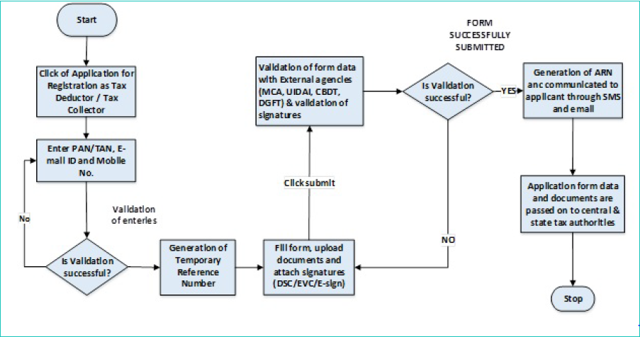
TDS Registration process flow

Slide 33
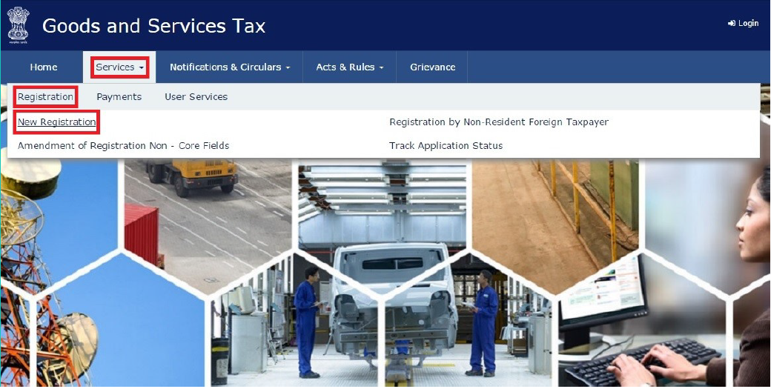
Steps involved in applying for Registration as a Tax Deductor on the GST portal?
1. Access the https://www.gst.gov.in/ URL. The GST Home page is displayed.
2. Click the Services > Registration > New Registration option.

Slide 34
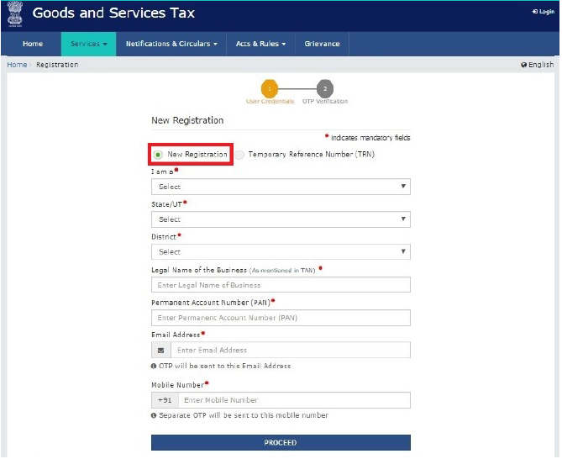
Steps involved in applying for Registration as a Tax Deductor on the GST portal?
The Application form is divided into two parts as Part A and Part B.
Part A:
3. The New Registration page is displayed. Select the New Registration option.

Slide 35
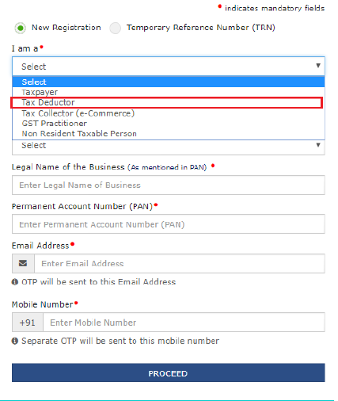
Steps involved in applying for Registration as a Tax Deductor on the GST portal?
5. In the I am a drop down list, select the Tax Deductor as the type of taxpayer to be registered.
6. In the State/UT and District drop down list, select the state for which registration is required and district.
7. In the Legal Name of the Tax Deductor (As mentioned in PAN) field, enter the legal name of your Tax Deductor as mentioned in the PAN database.
8. In the Permanent Account Number (PAN) field, enter PAN number.

Slide 36
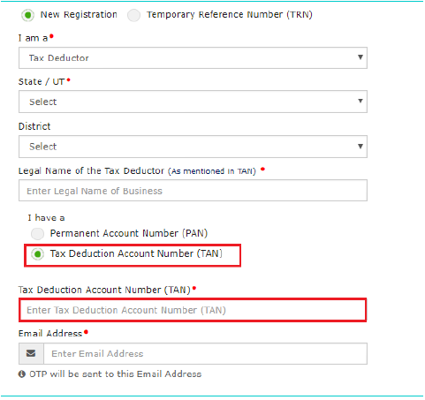
Steps involved in applying for Registration as a Tax Deductor on the GST portal?
9. In the Email Address field, enter the unique email address of the Primary Authorized Signatory.
10. In the Mobile Number field, enter the valid unique Indian mobile number of the Primary Authorized Signatory.
Note: Different One Time Password (OTP) will be sent on your email address and mobile number you just mentioned for authentication.
11. In the Type the characters you see in the image below field, enter the captcha text.
12. Click the PROCEED button.

Slide 37
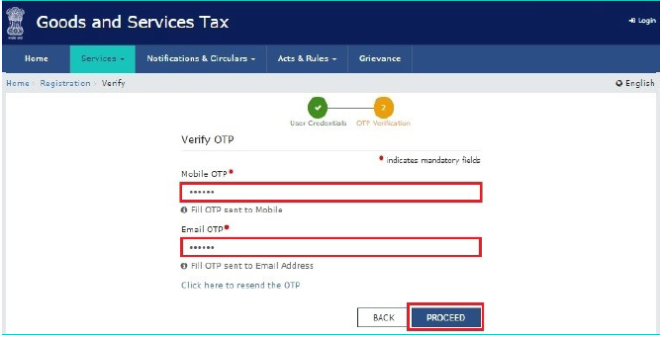
Steps involved in applying for Registration as a Tax Deductor on the GST portal?

Slide 38
Steps involved in applying for Registration as a Tax Deductor on the GST portal?
After successful validation, you will be directed to the OTP Verification page.
13. In the Mobile OTP field, enter the OTP you received on your mobile number entered in PART-A of the form. OTP is valid only for 10 minutes.
14. In the Email OTP field, enter the OTP you received on your email address entered in PART-A of the form. OTP is valid only for 10 minutes.
Note: OTP sent to mobile number and email address are separate. In case OTP is invalid, try again by clicking the Click here to resend the OTP link. You will receive the OTP on your registered mobile number or email ID again. Enter both the newly received OTPs again.
15. Click the PROCEED button.

Slide 39
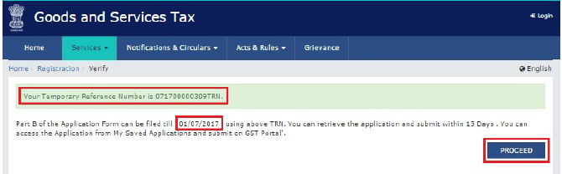
Steps involved in applying for Registration as a Tax Deductor on the GST portal?

Slide 40
Steps involved in applying for Registration as a Tax Deductor on the GST portal?
16. The system generated 15-digit Temporary Reference Number (TRN) is displayed.
Note: You will receive the TRN acknowledgment information on your e-mail address as well as your mobile number. Note that
below the TRN the expiry date of the TRN will also be mentioned.
17. Click the PROCEED button.
Alternatively, you can also click Services > Registration > New Registration option and select the Temporary Reference
Number (TRN) radio button to login using the TRN.

Slide 41
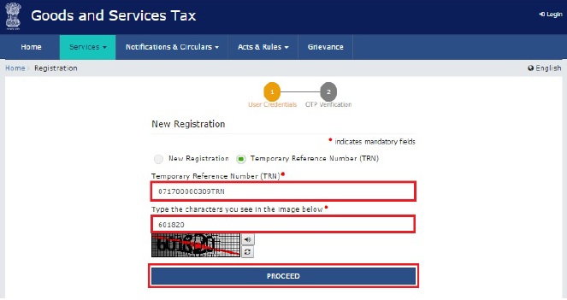
Steps involved in applying for Registration as a Tax Deductor on the GST portal?

Slide 42
Steps involved in applying for Registration as a Tax Deductor on the GST portal?
PART B:
18. In the Temporary Reference Number (TRN) field, enter the TRN generated.
19. In the Type the characters you see in the image below field, enter the captcha text.
20. Click the PROCEED button. The Verify OTP page is displayed. You will receive same Mobile OTP and Email OTP. These OTPs are different from the OTPs you received in previous step.

Slide 43
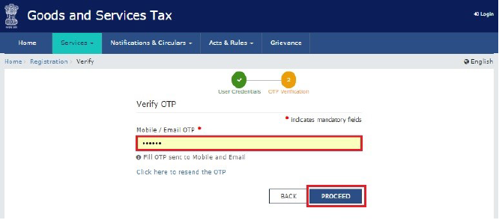
Steps involved in applying for Registration as a Tax Deductor on the GST portal?

Slide 44
Steps involved in applying for Registration as a Tax Deductor on the GST portal?
21. In the Mobile / Email OTP field, enter the OTP you received on your mobile number and email address. OTP is valid only
for 10 minutes.
Note: OTP sent to mobile number and email address are same. In case OTP is invalid, try again by clicking the Click here to resend the OTP link. You will receive the OTP on your registered mobile number or email ID again. Enter the newly received
OTP again.

Slide 45
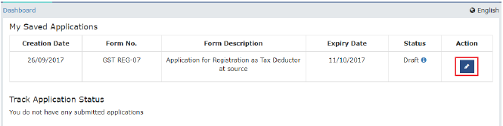
Steps involved in applying for Registration as a Tax Deductor on the GST portal?

Slide 46
Steps involved in applying for Registration as a Tax Deductor on the GST portal?
22. The My Saved Application page is displayed. Under the Action column, click the Edit icon (icon in blue square with white pen).
Note:
Notice the expiry date shown below in the screenshot. If the applicant doesn’t submit the application within 15 days, TRN and the entire information filled against that TRN will be purged after 15 days. The status of the registration application is ‘Draft’ unless the application is submitted. Once the application is submitted, the status is changed to ‘Pending for Validation’.
The Registration Application form with various tabs is displayed that must be filled sequentially.
On the top of the page, there are five tabs as Business Details, Drawing and Disbursing Officer, Authorized Signatory,
Office Address of Tax Deductor and Verification. Click each tab to enter the details.

Slide 47
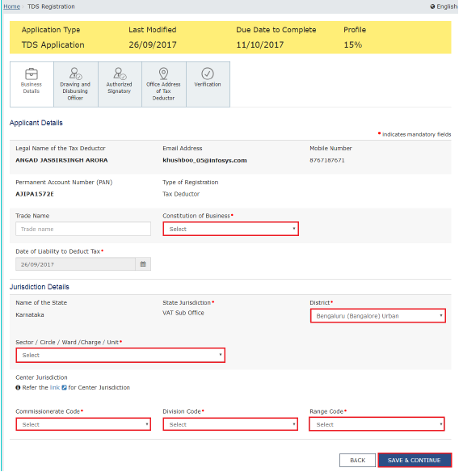
Steps involved in applying for Registration as a Tax Deductor on the GST portal?

Slide 48
Steps involved in applying for Registration as a Tax Deductor on the GST portal?
Business Details tab:
The Business Details tab is selected by default. This tab displays the information to be filled for the business details required
for registration.
a) In the Trade Name field, enter the trade name of your business.
Note: Trade name of the business is different from the legal name of the business.
b) In the Constitution of Business drop-down list, select the type of constitution of your business. This will be validated with
the CBDT Database for a match with the PAN entered in Part A of the form.
c) In the District drop-down list, select the district of your business.
d) In the Sector/ Circle / Ward/ Charge/ Unit drop-down list, select the appropriate choice.
e) In the Commissionerate Code, Division Code and Range Code drop-down list, select the appropriate choice.
f) Click the SAVE & CONTINUE button. You will notice a blue tick on the Business Details section indicating the completion of
the tab information and notice the Profile indicating the percentage completion of the application form.

Slide 49
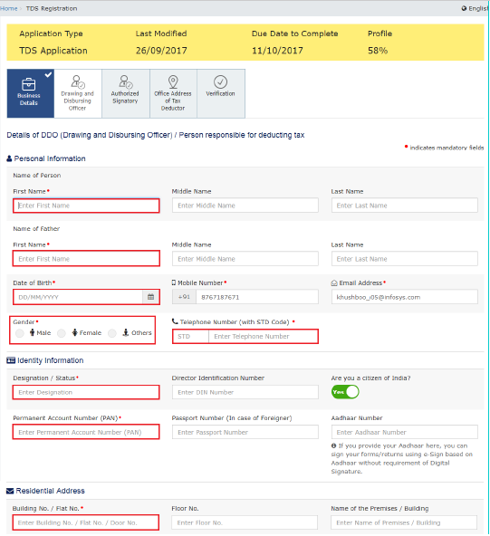
Steps involved in applying for Registration as a Tax Deductor on the GST portal?
a) In the Personal Information section, enter the personal details of the Drawing and Disbursing Officer like name, father’s
name, date of birth, telephone number, email address and gender.
b) In the Identity Information section, enter the official information of the Drawing and Disbursing Officer like designations
and PAN.
c) In the Residential Address section, enter the address details of the Drawing and Disbursing Officer. Based on the State
selected, select the district and enter the corresponding pin code.

Slide 50
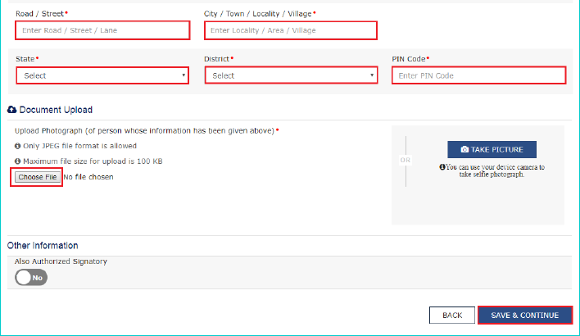
Steps involved in applying for Registration as a Tax Deductor on the GST portal?

Slide 51
Steps involved in applying for Registration as a Tax Deductor on the GST portal?
d) In the Document Upload section, click the Choose file button. Navigate and select the photograph of the Drawing and
Disbursing Officer.
Note: Ensure that your photograph is in JPEG format and the file size is less than 100 KB.
e) In case Drawing and Disbursing Officer is the Primary Authorized Signatory, select the checkbox for Also Authorized
Signatory and details will be auto-populated in the Authorized Signatory tab.
f) Click the SAVE & CONTINUE button. You will notice a blue tick on the Drawing and Disbursing Officer section indicating the
completion of the tab information and notice the Profile indicating the percentage completion of the application form.

Slide 52
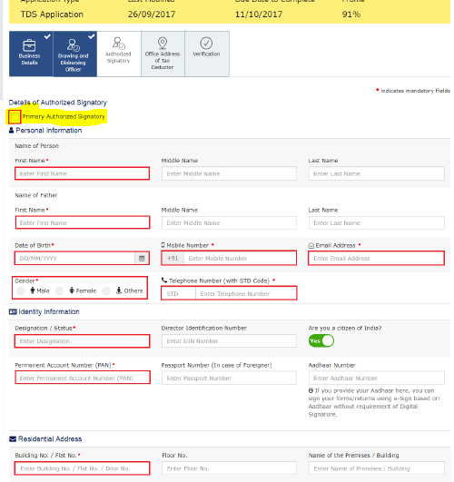
Steps involved in applying for Registration as a Tax Deductor on the GST portal?
Authorized Signatory tab:
This tab page displays the details of the authorized signatory. You can enter details of up to 10 authorized signatories.
If you selected the Drawing and Disbursing Officer as the Authorized Signatory, the system will skip this section and details of
Drawing and Disbursing Officer will be auto populated.
If you did not select ‘Also Authorized Signatory’ in previous Drawing and Disbursing Officer tab, enter all the details of the
authorized signatory and click SAVE AND CONTINUE at the bottom of the screen.

Slide 53
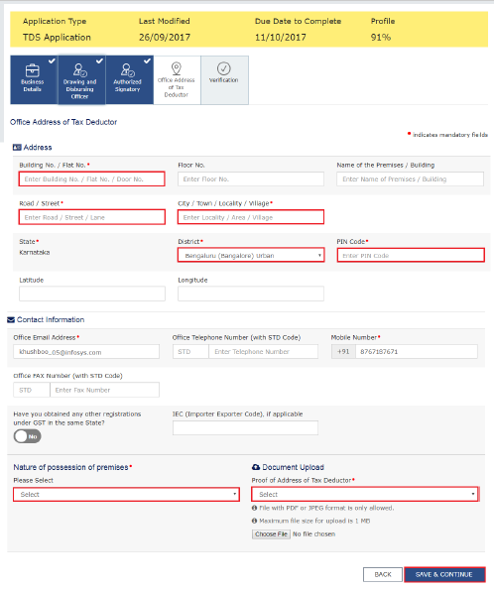
Steps involved in applying for Registration as a Tax Deductor on the GST portal?

Slide 54
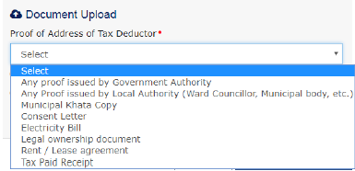
Steps involved in applying for Registration as a Tax Deductor on the GST portal?
Office Address of Tax Deductor tab:
This tab page displays the details of the office address of Tax Deductor.
a) In the Address section, enter the address details of the principal place of business.
Based on the District selected enter the corresponding pin code.
b) In the Contact Information section, enter the official contact details like Email, telephone number (with STD Code), mobile number field and fax number (with STD Code).
c) Select Yes in case you have obtained any other registrations under GST in the same State.
d) In the Nature of Possession of Premises drop-down list, select the nature of possession of premises.
e) In the Document Upload section, click the Choose file button. Navigate and select the Proof of address of Tax Deductor.
Note: You can upload PDF or JPEG files with maximum file size for upload of as 1 MB.

Slide 55
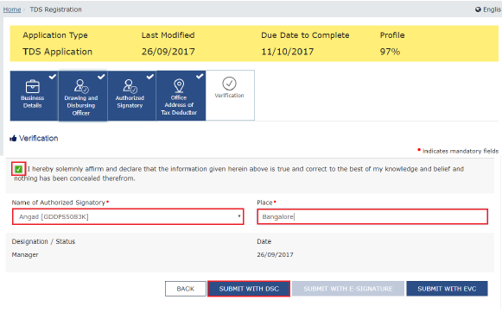
Steps involved in applying for Registration as a Tax Deductor on the GST portal?
Verification tab:
This tab page displays the details of the verification for authentication of the
details submitted in the form.
a) Select the Verification checkbox.
b) In the Name of Authorized Signatory drop-down list, select the name of authorized signatory.
c) In the Place field, enter the place where the form is filed.
d) After filling the enrolment application, you need to digitally sign the application using Digital Signature Certificate (DSC) or
E-Signature. Submission of application with the details is NOT completed unless DSC or E-Signature is affixed.
Note:
For E-Sign, you must update your Aadhaar number in the Applicant Details section. After submission, you cannot make any changes to your application.

Slide 56
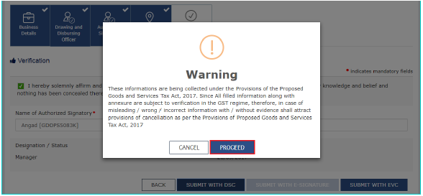
Steps involved in applying for Registration as a Tax Deductor on the GST portal?
In Case of DSC:
e) Click the SUBMIT WITH DSC button.
f) Click the PROCEED button.
Note:
Make sure your DSC dongle is inserted in your laptop/ desktop.
Make sure emSigner (from eMudra) is running on your laptop/ desktop with administrator permissions.
To check if the emSigner is running on your laptop/ desktop, perform the following steps:
1. Click the item tray.
2. Double click the emSigner icon.
3. Click the Hide Service button to minimize the dialog box.
g) Select the certificate and click the SIGN button.
Note: To view the details of your DSC, click the View Certificate button

Slide 57
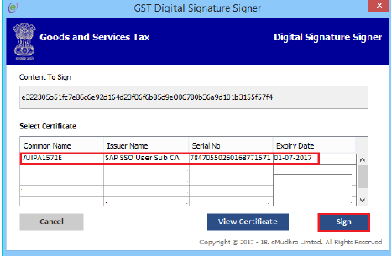
Steps involved in applying for Registration as a Tax Deductor on the GST portal?
h) Select the certificate and click the SIGN button.

Slide 58
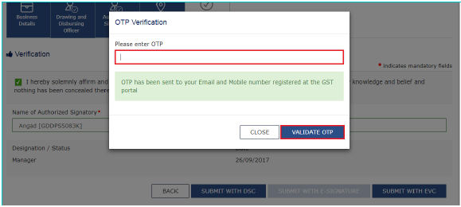
Steps involved in applying for Registration as a Tax Deductor on the GST portal
In Case of E-Signature:
e) Click the SUBMIT WITH E-SIGNATURE button.
f) In the Please select Service Provider option, select the appropriate Service Provider.
Note: C-DAC and NSDL are e-sign Service Providers (Both are free of cost).
g) Select the checkbox for declaration.
Note: OTP will be sent to your e-mail address and mobile phone number registered with Aadhaar.
h) Click the CONTINUE button.
i) Verify Aadhaar OTP screen is displayed. Enter the OTP received on your e-mail address and mobile phone number
registered with Aadhaar. Click the SUBMIT button.
In Case of EVC:
e) Click the SUBMIT WITH EVC button.
f) Enter the OTP sent to email and mobile number of the Authorized Signatory registered at the GST Portal and click the
VALIDATE OTP button.

Slide 59
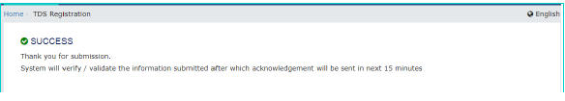
Steps involved in applying for Registration as a Tax Deductor on the GST portal?
The success message is displayed. You will receive the acknowledgement in next 15 minutes on your registered e-mail address and mobile phone number. Application Reference Number (ARN) receipt is sent on your e-mail address and mobile phone number.

Slide 60
Crediting the TDS deducted in the cash ledger of the DDOs

Slide 62
Generation & Filing of GSTR-7 along with Payment of taxes & Amendments

Slide 63
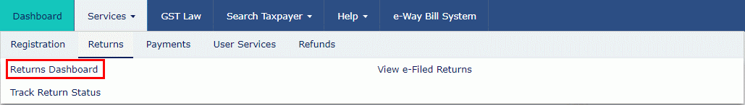
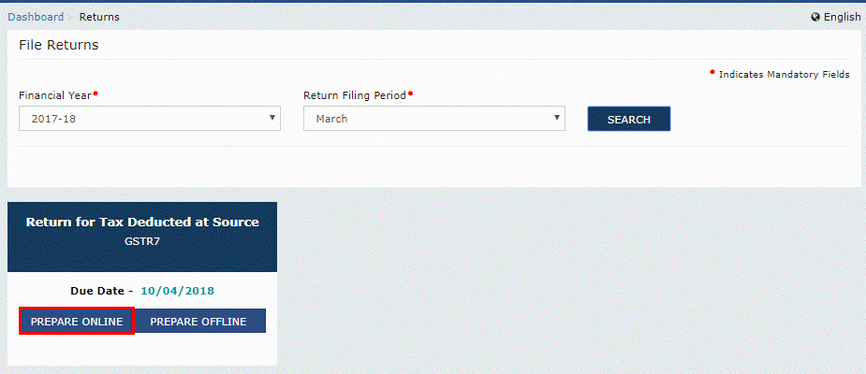
Tax deduction at source-Return GSTR-07
Tax Deducted at Source

Slide 64
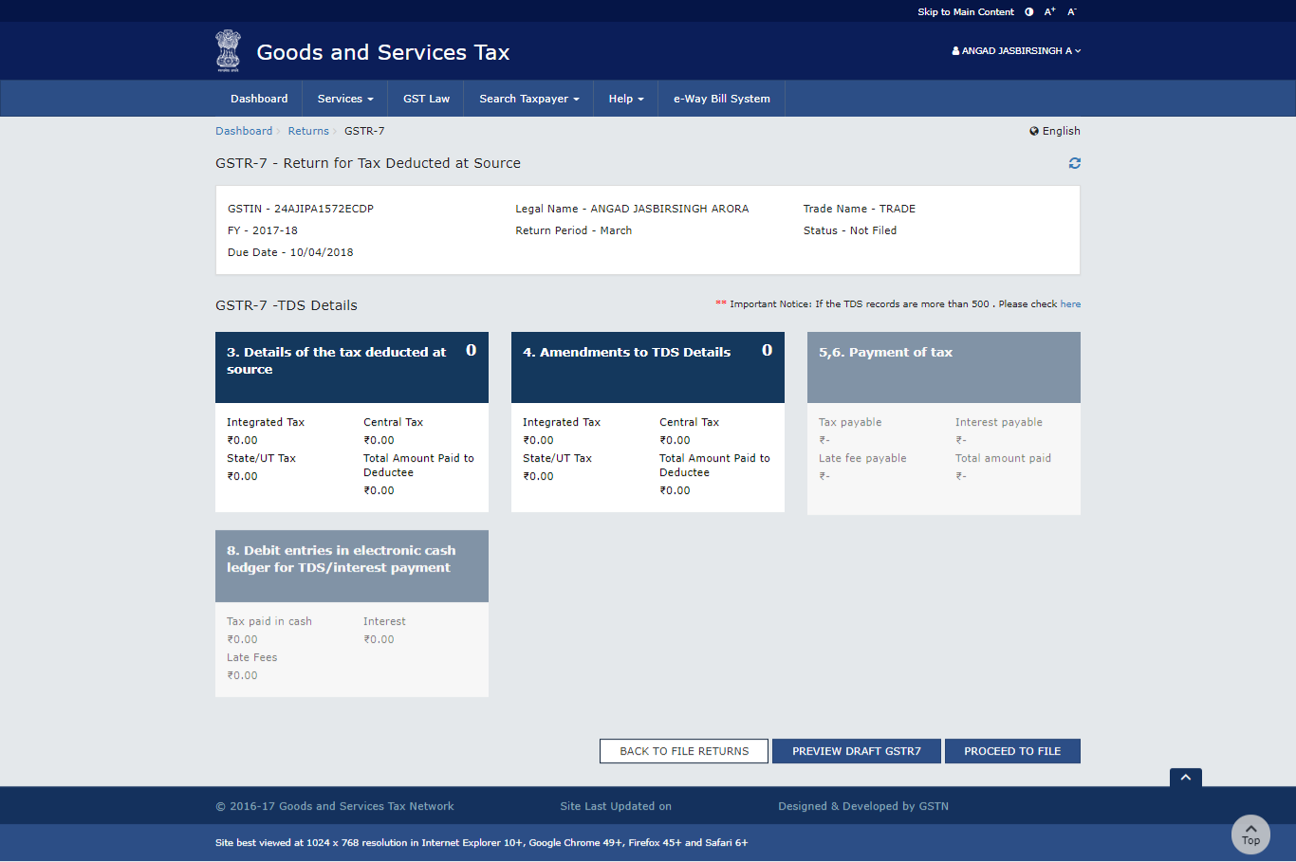
Tax deduction at source-Return GSTR-07
Tax Deducted at Source
Returns

Slide 65
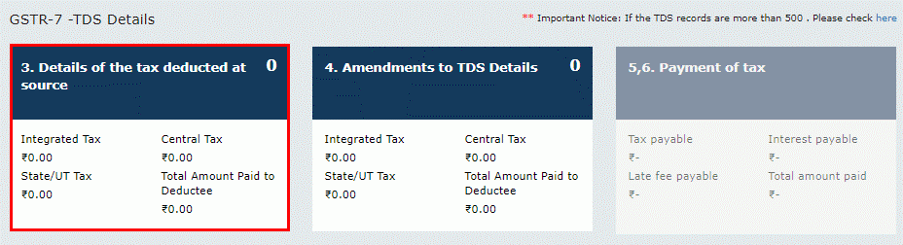
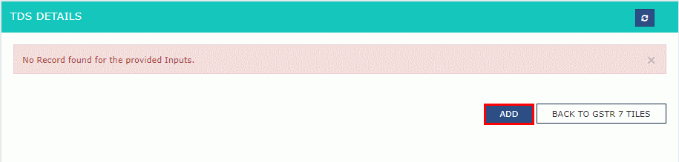
Tax deduction at source-Return GSTR-07

Slide 66
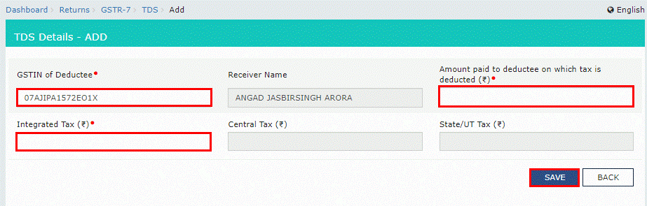
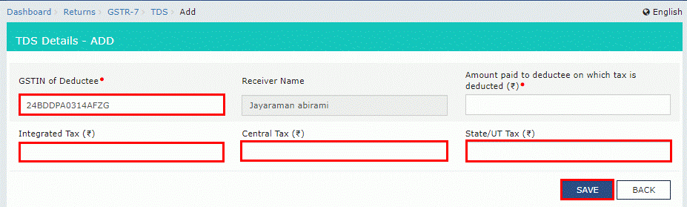
Tax deduction at source-Return GSTR-07
Tax Deducted at Source

Slide 67
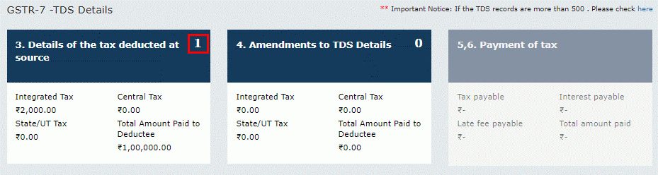
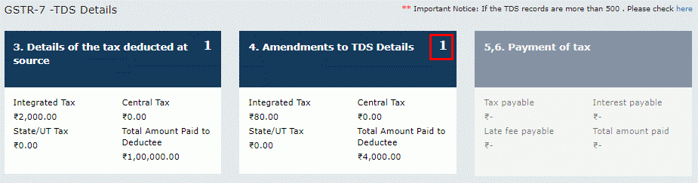
Tax deduction at source-Return GSTR-07
Tax Deducted at Source

Slide 68
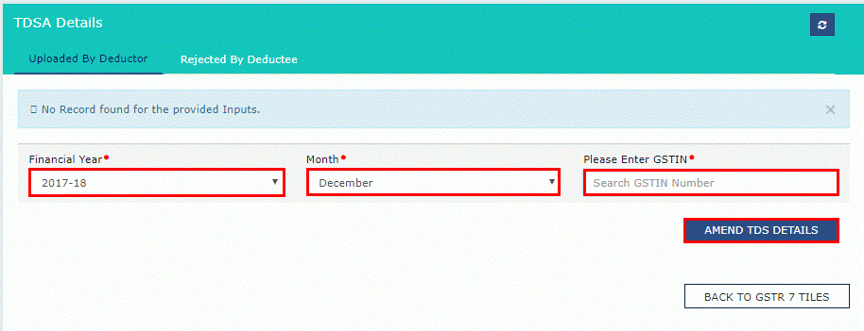
Tax deduction at source-Return GSTR-07
Tax Deducted at Source

Slide 69
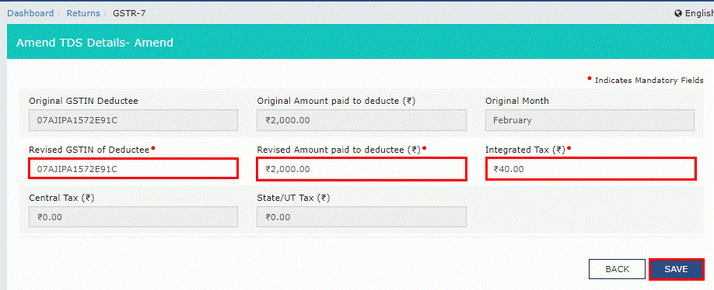
Tax deduction at source-Return GSTR-07
Tax Deducted at Source

Slide 70
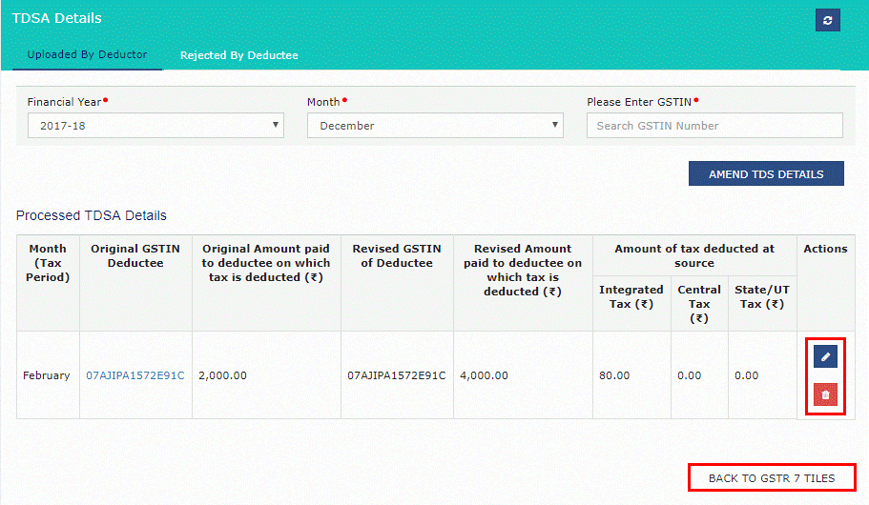
Tax deduction at source-Return GSTR-07
Tax Deducted at Source

Slide 71
Tax deduction at source-Return GSTR-07
Tax Deducted at Source

Slide 72
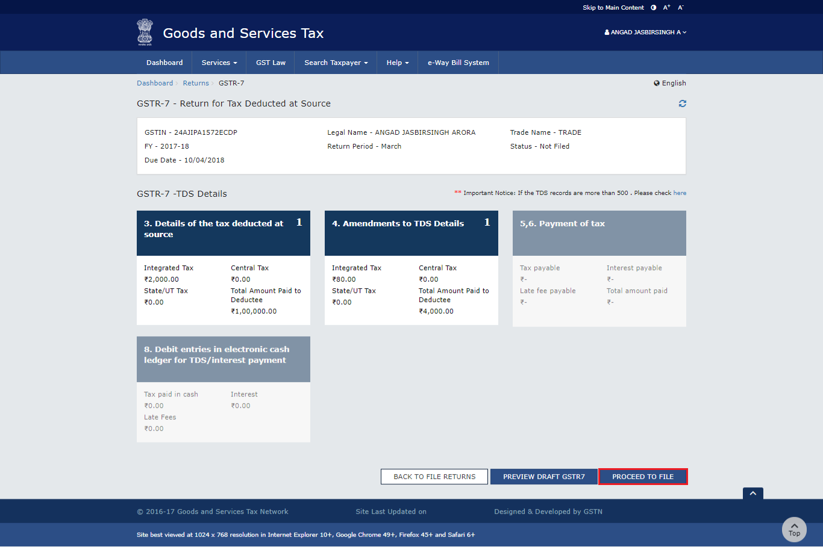
Tax deduction at source-Return GSTR-07
Tax Deducted at Source
Returns

Slide 73
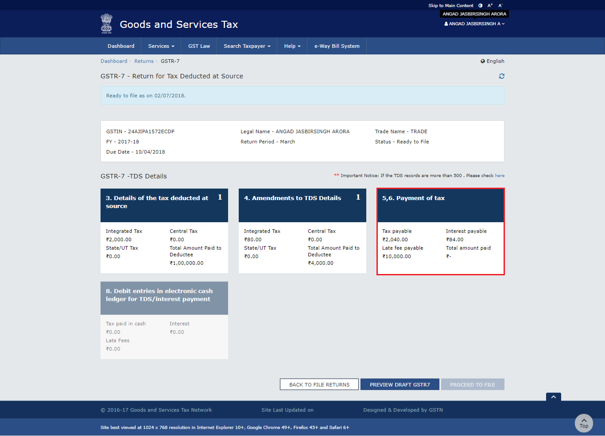
Tax deduction at source-Return GSTR-07
Tax Deducted at Source
Returns

Slide 74
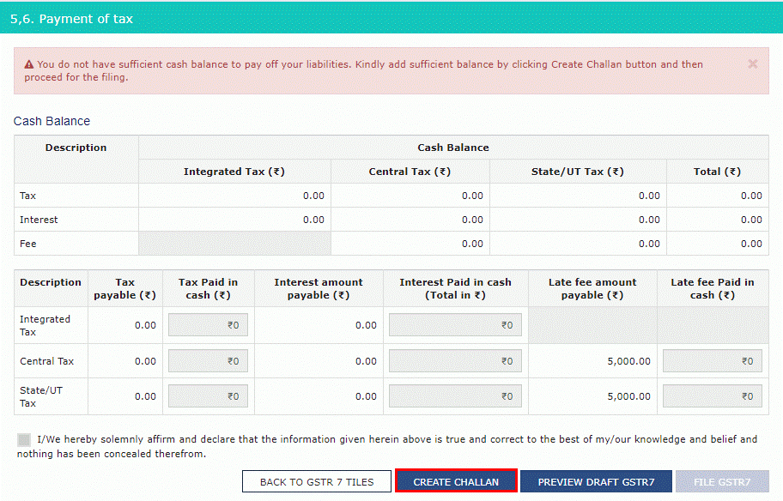
Tax deduction at source-Return GSTR-07
Tax Deducted at Source
Returns

Slide 75
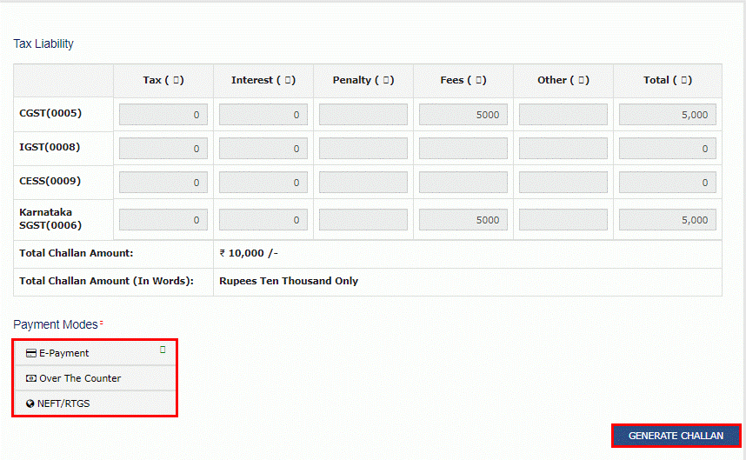
Tax deduction at source-Return GSTR-07
Tax Deducted at Source

Slide 76
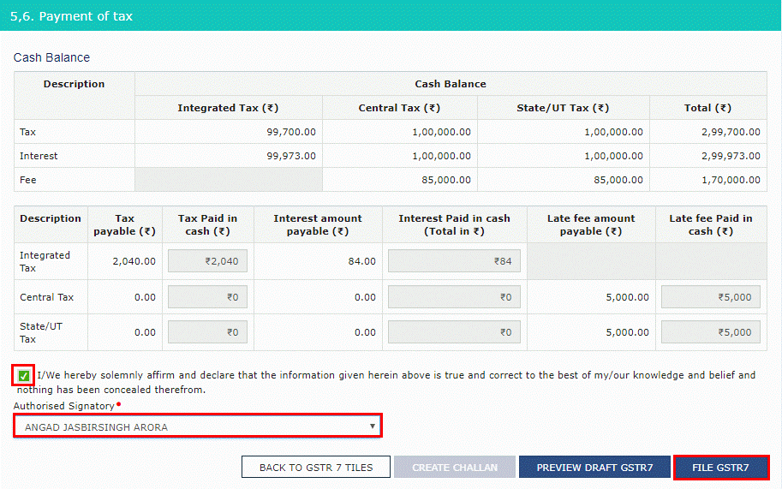
Tax deduction at source-Return GSTR-07
Tax Deducted at Source

Slide 77
OFFLINE UTILITY

Slide 78
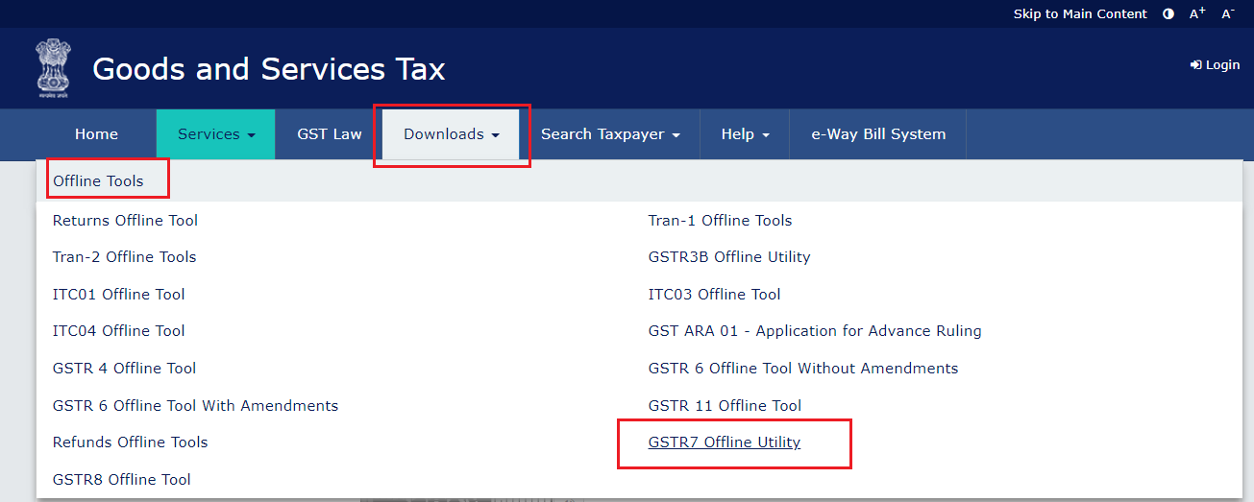
Tax deduction at source-Return GSTR-07
Tax Deducted at Source

Slide 79
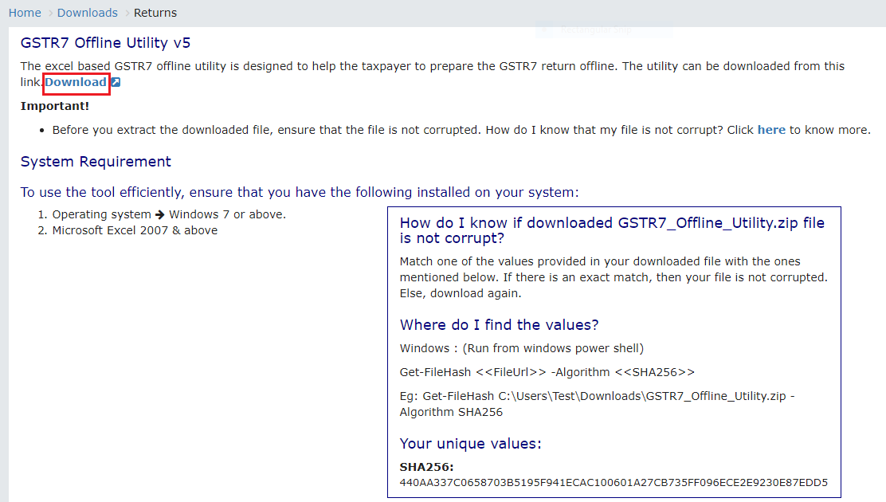
Tax deduction at source-Return GSTR-07
Tax Deducted at Source

Slide 80
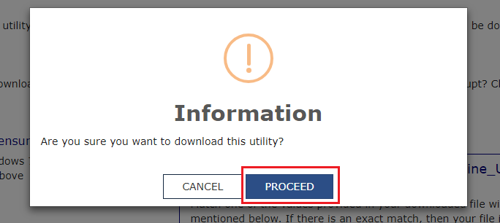
Tax deduction at source-Return GSTR-07
Tax Deducted at Source

Slide 81
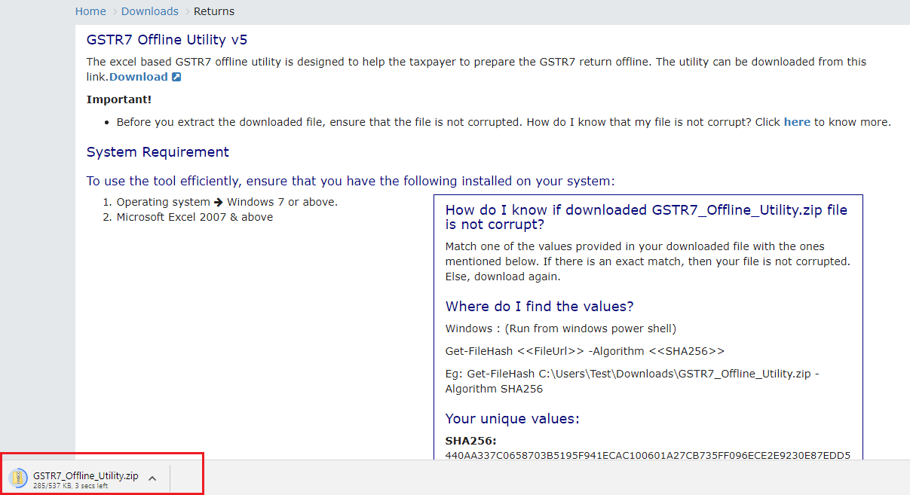
Tax deduction at source-Return GSTR-07
Tax Deducted at Source

Slide 82
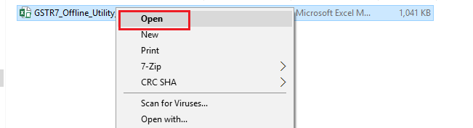
Tax deduction at source-Return GSTR-07
Tax Deducted at Source
To open the downloaded GSTR-7 Offline Utility Excel Worksheet, perform following steps:
1. Extract the files from the downloaded zipped folder GSTR7_Offline_Utility.zip and you will see GSTR7_Offline_Utilityexcel file in the unzipped folder. Right-click and click Open.

Slide 83
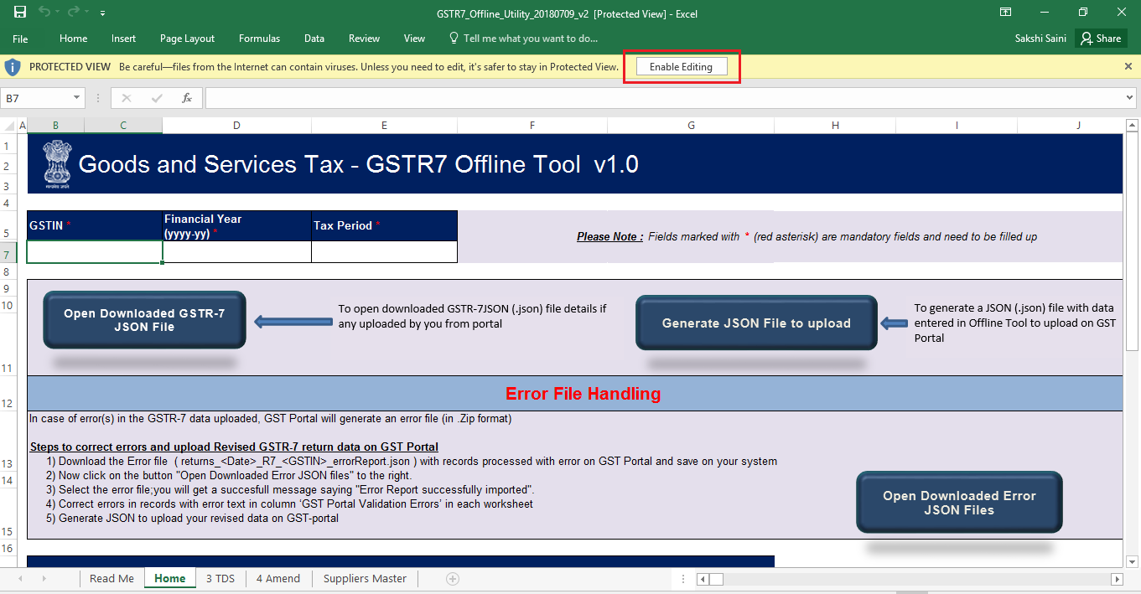
Tax deduction at source-Return GSTR-07
Tax Deducted at Source
2. Click Enable Editing.

Slide 84
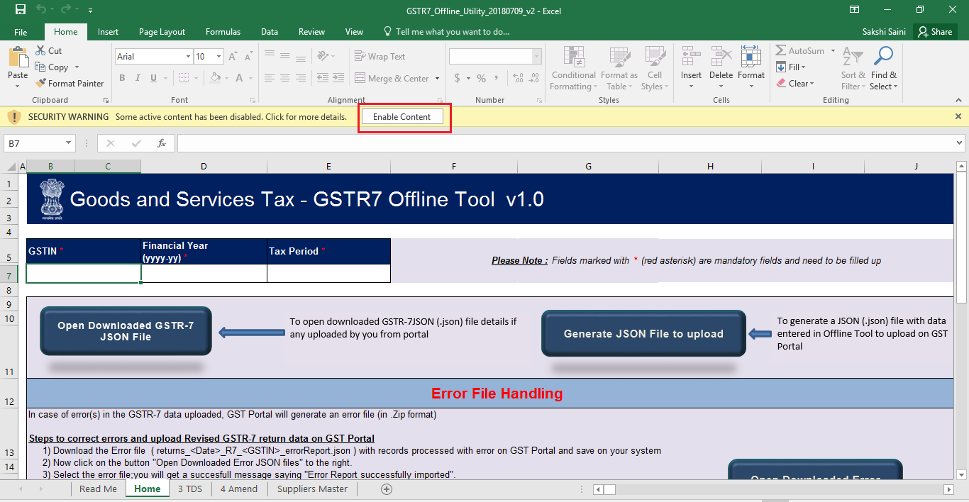
Tax deduction at source-Return GSTR-07
Tax Deducted at Source
3. Click Enable Content. Then, click the Read Me tab.

Slide 85
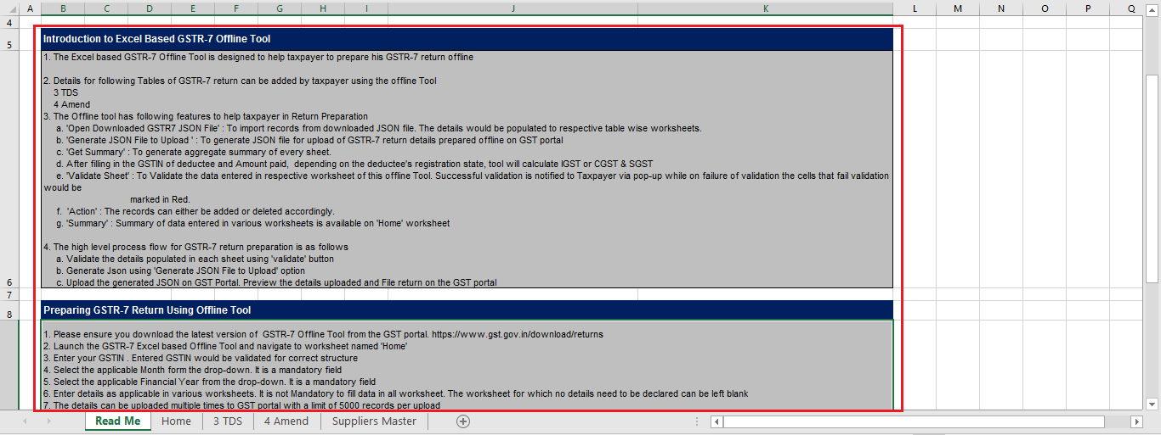
Tax deduction at source-Return GSTR-07
Tax Deducted at Source
4. Read Me page is displayed. It contains introduction and help instructions. Scroll down to read all the instructions carefully. Once you have completed your reading, you can now proceed to enter TDS details in the worksheet.

Slide 86
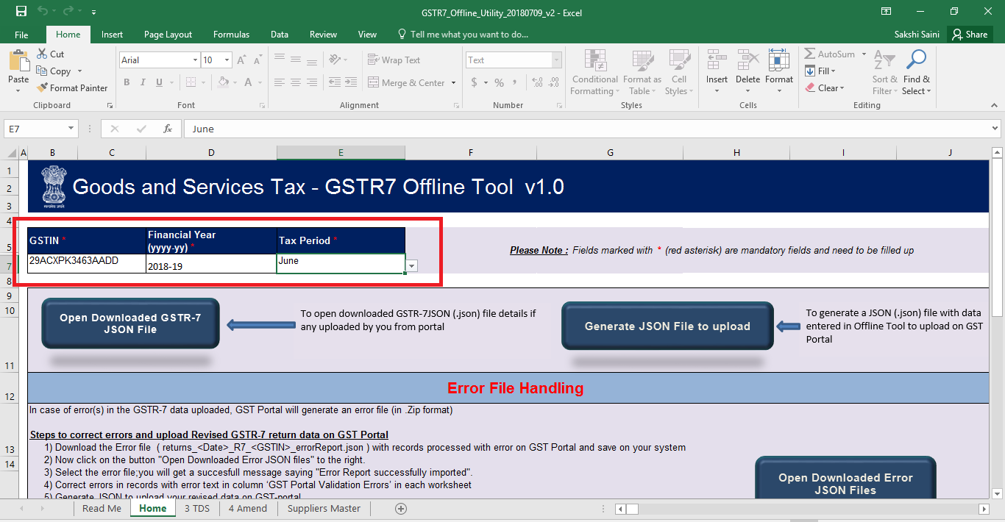
Tax deduction at source-Return GSTR-07
Tax Deducted at Source
To add table-wise details in the Worksheet, perform following steps:
1. Go to the Home tab and enter GSTIN, Financial Year (select from the drop-down list) and
Tax Period (select from the drop-down list).

Slide 87
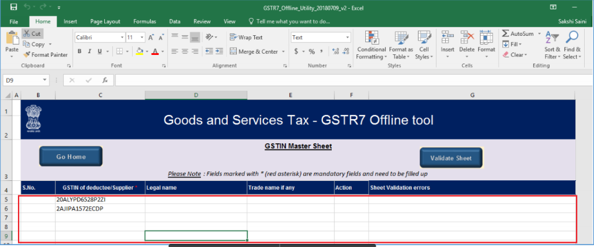
Tax deduction at source-Return GSTR-07
1. Go to the Suppliers Master tab and enter GSTIN and other details of the deductee or suppliers. This will help you easily populate data in the Table 3 and Table 4.Entering details in the Suppliers Master sheet is not mandatory. You can update the details in Table no 3 and 4 without updating the details in suppliers Master.
2a. Column B S.NO., will get automatically populated after you click the Validate Sheet button.
2b. Fill Column C, GSTIN of deductee/Supplier *, with active GSTIN. You can verify validity of GSTIN from the GST portal: Home > Search Taxpayer > Search by GSTIN/UIN. This is the only mandatory field in this sheet.
2c. In Column D, Legal name, enter legal name of the deductee/supplier (this field is not mandatory)
2d. In Column E, Trade name if any, enter trade name of the deductee/supplier (this field is not mandatory)
2e. In Column F, Action, select “Delete” only if you want to delete from the Master sheet. (this field is not mandatory)

Slide 88
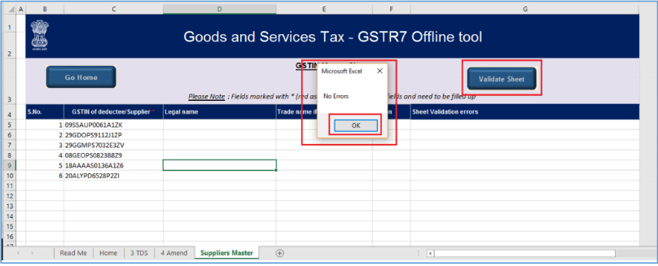
Tax deduction at source-Return GSTR-07
3. Click the Validate Sheet button. No Errors popup appears. Click OK.

Slide 89
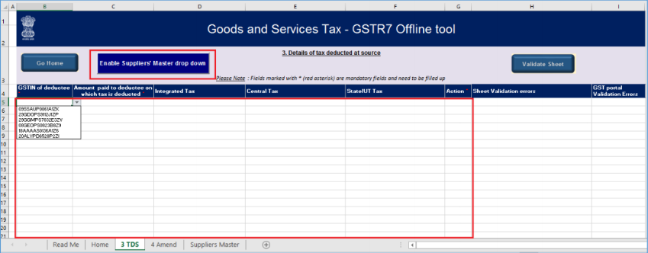
Tax deduction at source-Return GSTR-07
4. Go to 3 TDS tab and enter details in Columns B, C, D, E, F and G.

Slide 90

Tax deduction at source-Return GSTR-07
5. Once you have entered all the TDS details, click the Validate Sheet button.
5a. In case of successful validation, Column H of this sheet will be empty and you can directly perform Step 8.
5b. In case of unsuccessful validation, error-intimation popup will appear and the cells
of the Column H will show “Error found in row”. Close the popup by clicking OK.

Slide 91

Tax deduction at source-Return GSTR-07
6.Point your mouse-cursor on each of the red-highlighted cells to read the error
description of each cell. A yellow description box will appear. Correct the errors as mentionedin the description box.
Alternatively, click the Review ribbon-tab > Show All Comments link to view the comments for fields with errors.

Slide 92

Tax deduction at source-Return GSTR-07
7. After you have corrected all the errors, again click the Validate Sheet button.

Slide 93

Tax deduction at source-Return GSTR-07
8.As no errors were found, Column H of this sheet will be empty and a No errors popup appears. Click OK.

Slide 94

Tax deduction at source-Return GSTR-07
9. If you have to make any amendments related to previous month(s), go to the 4 Amend tab. Otherwise, perform steps mentioned in the following hyperlink: Generate JSON File to upload

Slide 95

Tax deduction at source-Return GSTR-07
9a Enter details from Column B, C, D, E, F, G, H, I, J, K, L, M and click the Validate Sheet button. Perform Steps 5 to 8 mentioned above, in this sheet also, until all the cells of the sheet are error-free.

Slide 96

Tax deduction at source-Return GSTR-07
D. Generate JSON File to upload
To generate JSON File to upload, perform following steps:
1. From the tab you are on, go to the Home tab by either clicking the Go Home button or clicking the Home tab.

Slide 97

Tax deduction at source-Return GSTR-07
Tax deduction at source-Return GSTR-07
2. On the Home tab, scroll down and click on the Get Summary button.

Slide 98

Tax deduction at source-Return GSTR-07
Tax deduction at source-Return GSTR-07
3. Summary of all the entries filled in 3 TDS and 4 Amend sheets is displayed.

Slide 99

Tax deduction at source-Return GSTR-07
4. Scroll up and click the Generate JSON File to upload button.

Slide 100

Tax deduction at source-Return GSTR-07
5. A Save As pop-up window appears. Select the location where you want to save the JSON file, enter the file name and click the SAVE button.

Slide 101
Tax deduction at source-Return GSTR-07
4. Scroll up and click the Generate JSON File to upload button.

Slide 102

Tax deduction at source-Return GSTR-07
5. A window pop-up appears with a message that the file has been generated and placed at the desired location and now it can be uploaded on the portal. Click OK.

Slide 103

Tax deduction at source-Return GSTR-07
E. Upload the generated JSON File on GST Portal
To upload the generated JSON File on the GST Portal, perform following steps:
1. Access the www.gst.gov.in URL. The GST Home page is displayed.
2. Login to the portal with valid credentials.
3. Dashboard page is displayed. Click Return Dashboard. Alternatively, you can also access
the Return Dashboard by the following navigation: Services > Returns > Returns
Dashboard

Slide 104

Tax deduction at source-Return GSTR-07
4. The File Returns page is displayed. Select the Financial Year & Return Filing Period (Month) for which you want to file the return from the drop-down list and click the SEARCH button.

Slide 105

Tax deduction at source-Return GSTR-07
5. The GSTR-7 tile is displayed, with an Important Message box on the right. In the GSTR-7
tile, click the PREPARE OFFLINE button.

Slide 106

Tax deduction at source-Return GSTR-07
6. The Upload section of the Offline Upload and Download for GSTR-7 page is displayed. Click the Choose File button

Slide 107

Tax deduction at source-Return GSTR-07
7. Browse and navigate the JSON file to be uploaded from your computer. Click the Open button.

Slide 108

Tax deduction at source-Return GSTR-07
8. The Upload section page is displayed. A green message appears confirming successful upload and asking you to wait while the GST system validates the uploaded data. And, below the message, is the Upload History table showing Status as “In-progress”.

Slide 109

Tax deduction at source-Return GSTR-07
9. Once the validation is complete, one of the following two instances can occur:
9a No error was found. Then, the Upload History table will show the Status as “Processed” and Error Report as “NA”.

Slide 110

Tax deduction at source-Return GSTR-07
I. You can download the successfully uploaded details under ‘Download’ section. Go to Download section and click the Generate File button. A green message is displayed confirming your request and asking you to wait for 20 minutes
While you wait for the file to be generated, you can preview the successfully uploaded details in the Form GSTR-7 on the GST portal. To do this, follow the steps mentioned in the following hyperlink: Preview Form GSTR-7 on the GST Portal

Slide 111


Tax deduction at source-Return GSTR-07
II After 20 minutes, a link is displayed. Click on the link to download your validated zipped file
III. Unzip and save the Json File in your machine.

Slide 112

Tax deduction at source-Return GSTR-07
I. Click Generate error report hyperlink. A confirmation-message is displayed and Columns Status and Error Report change as shown.

Slide 113

Tax deduction at source-Return GSTR-07
II. Once the error report is generated, Download error report link is displayed in the Column Error Report. Click the Download error report link to download the zipped error report.

Slide 114

Tax deduction at source-Return GSTR-07
III. Unzip and save the Json File in your machine.

Slide 115

Tax deduction at source-Return GSTR-07
F. Preview Form GSTR-7 on the GST Portal To preview Form GSTR-7 on the GST Portal, perform following steps:
1. Access the http://www.gst.gov.in URL. The GST Home page is displayed. 2. Login to the portal with valid credentials. 3. Dashboard page is displayed. Click Return Dashboard. Alternatively, you can also access the Return Dashboard by the following navigation: Services > Returns > Returns Dashboard

Slide 116

Tax deduction at source-Return GSTR-07
5. The File Returns page is displayed. Select the Financial Year & Return Filing Period (Month) for which you want to file the return from the drop-down list and click the SEARCH button.

Slide 117

Tax deduction at source-Return GSTR-07
6. The GSTR-7 box is displayed, with an Important Message box on the right. In the GSTR-7 box, click the PREPARE ONLINE button.

Slide 118

Tax deduction at source-Return GSTR-07
7. The details you had successfully uploaded on the portal using the Offline Utility would be displayed in boxes 3 and 4. Click the PREVIEW button. The draft Summary page of your Form GSTR-7 gets downloaded.

Slide 119

Tax deduction at source-Return GSTR-07
8. The downloaded PDF is displayed. It is recommended that you review the summary of entries made in different sections carefully. The PDF file generated would bear watermark of draft as the details are yet to be filed.

Slide 120

Tax deduction at source-Return GSTR-07
G. Open Downloaded GSTR-7 JSON File(s), if needed To open the downloaded GSTR-7 JSON File, perform following steps: 1. Open GSTR-7 Offline Utility and go to the Home tab. Click the Open Downloaded GSTR-7 JSON File button.

Slide 121

Tax deduction at source-Return GSTR-07
2. Browse the JSON(.json) file and click the Open button.

Slide 122

Tax deduction at source-Return GSTR-07
3. Select the downloaded JSON (.json) file and click on OK to proceed.

Slide 123


Tax deduction at source-Return GSTR-07
4. Success message will be displayed. Click the OK button to proceed.
5. Now all the TDS entries that were successfully uploaded on the GST Portal would be auto-populated in the respective sheets: 3 TDS and 4 Amend

Slide 124
Tax deduction at source-Return GSTR-07
6. Modify the TDS details as per requirement.
7. After making the modifications, click the Validate Sheet button to validate the sheets.
8. After each section is successfully validated, click the Get Summary button to update the summary on Home tab.
9. Summary is displayed for all the sections.
GST portal allows you to modify and upload JSON multiple times before it is filed. An important point to note here is that if some TDS details exist from previous upload, it will be updated with latest uploaded details. All new TDS entries will be added as new entries

Slide 125

Tax deduction at source-Return GSTR-07
H. Open Downloaded Error GSTR-7 JSON File(s), if any To open the downloaded Error GSTR-7 JSON File, perform following steps:
1. Open GSTR-7 Offline Utility and go to the Home tab. Under the section Error File Handling, click the Open Downloaded Error JSON Files button.

Slide 126

Tax deduction at source-Return GSTR-07
2. A file dialog box will open. Navigate to extracted error file. Select the file and click the OK button.

Slide 127


Tax deduction at source-Return GSTR-07
3. Success message is displayed. Click the OK button to proceed
4. Navigate to 3 TDS and 4 Amend sheets. The erroneous entries that failed validation is displayed. Correct the errors, as mentioned in the column “GST Portal Validation Errors” in each sheet.

Slide 128

Tax deduction at source-Return GSTR-07
5. After making the corrections, click the Validate Sheet button to validate the sheets. On successful validation, Column “GST portal Validation Errors” would become empty and No errors popup appears. Click OK.
From the tab you are on, go to the Home tab by either clicking the Go Home button or clicking the Home tab to generate summary

Slide 129
TDS Certificates
&
TDS Credit Receivables

Slide 130

TDS credit received Table

Slide 131

TDS credit received Table

Slide 132

TDS credit received Table

Slide 133

TDS credit received Table

Slide 134

TDS credit received Table

Slide 135

TDS credit received Table
TDS TCS credit received Table

Slide 136

TDS credit received Table
TDS TCS credit received Table

Slide 137

TDS credit received Table
TDS TCS credit received Table

Slide 138

TDS credit received Table
TDS TCS credit received Table

Slide 139

TDS credit received Table
TDS TCS credit received Table

Slide 140

TDS credit received Table

Slide 141

TDS Certificates
Tax Deducted at Source

Slide 142

TDS Certificates
Tax Deducted at Source

Slide 143

TDS Certificates
Tax Deducted at Source

Slide 144

TDS Certificates
Tax Deducted at Source

Slide 145

TDS Certificates
Tax Deducted at Source

Slide 146
Queries

Slide 147
Thank You

