Slide 1
Registration
Registration for Taxpayers
How to Apply for a New Registration: Demonstration
Notes:
Facilitation Notes: N/A

Slide 2
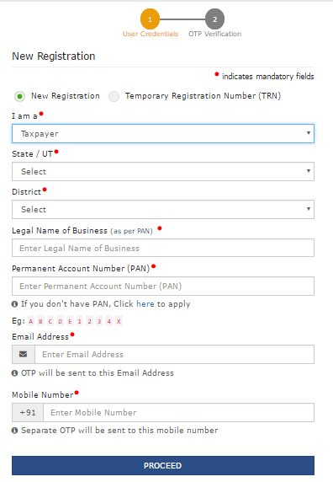
Registration
Registration for Taxpayers
How to Apply for a New Registration: New Registration Screen
Open the GST website & select New Registration
Enter the mandatory details
I am a
State/UT
District where Principal Place of Business is located
Legal Name of Business (as per PAN)
PAN
Email Address
Mobile Number
Click Proceed
Notes:
Facilitation Notes:
PAN Validation Issues
Question: Data given in CBDT doesn’t always match with the data that users enter in the GST portal. For example, the name might differ slightly. How does a taxpayer overcome this problem?
Answer: Please fill the name as per CBDT data. In case you wish to change/correct the name, please get it updated in CBDT data first.

Slide 3
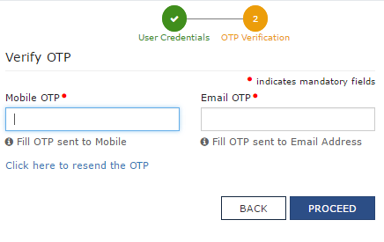
Registration
Registration for Taxpayers
How to Apply for a New Registration: New Registration Screen
4. Enter the Mobile OTP
5. Enter the Email OTP
6. Click Proceed
Notes:
Facilitation Notes:

Slide 4
Registration
Registration for Taxpayers
How to Apply for a New Registration: New Registration Screen
7. Temporary Reference Number (TRN) is generated
8. Click Home link to go back to Register Now
9. Click on Register Now again
10. Select Temporary Reference Number radio button
Notes:
Facilitation Notes:

Slide 5
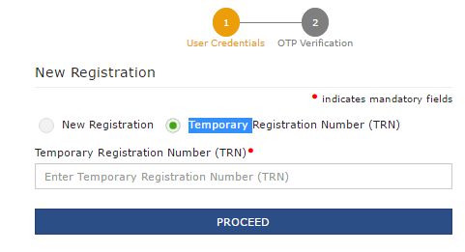
Registration
Registration for Taxpayers
How to Apply for a New Registration: New Registration Screen
11. Enter the TRN
12. Click Proceed
Notes:
Facilitation Notes:

Slide 6
Registration
Registration for Taxpayers
How to Apply for a New Registration: New Registration Screen
You can edit or delete the saved application here
The taxpayer can access the saved application on the GST portal at anytime using the TRN up to 15 days post generation of TRN.
The TRN helps maintain data for Casual taxpayer (Advance Tax Payment)
All applications saved by taxpayer appear in descending chronological order.
Notes:
Facilitation Notes:

Slide 7
Registration
Registration for Taxpayers
How to Apply for a New Registration: New Registration Screen
Duration for which applications can be saved
Registration
Amendment
Cancellation
15 Days
15 Days
15 Days
Once duration has expired, applications will be purged by the system
This section is related to Registration & associated activities
Notes:
Facilitation Notes:

Slide 8
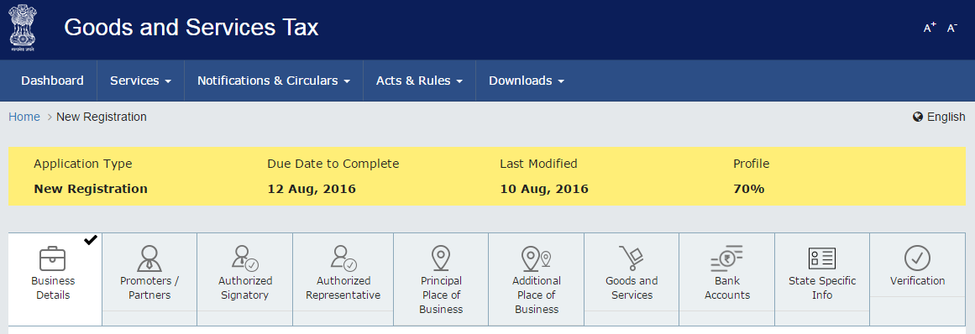
Registration
Registration for Taxpayers
How to Apply for a New Registration: Head of the Registration Form
The head contains all the sections of the application in order of sequence
You must fill all the mandatory details in each section before moving onto the next one
You cannot jump sections until data on the tab page is saved
Once you complete a section, it will be marked as complete with a check mark
Notes:
Facilitation Notes:

Slide 9
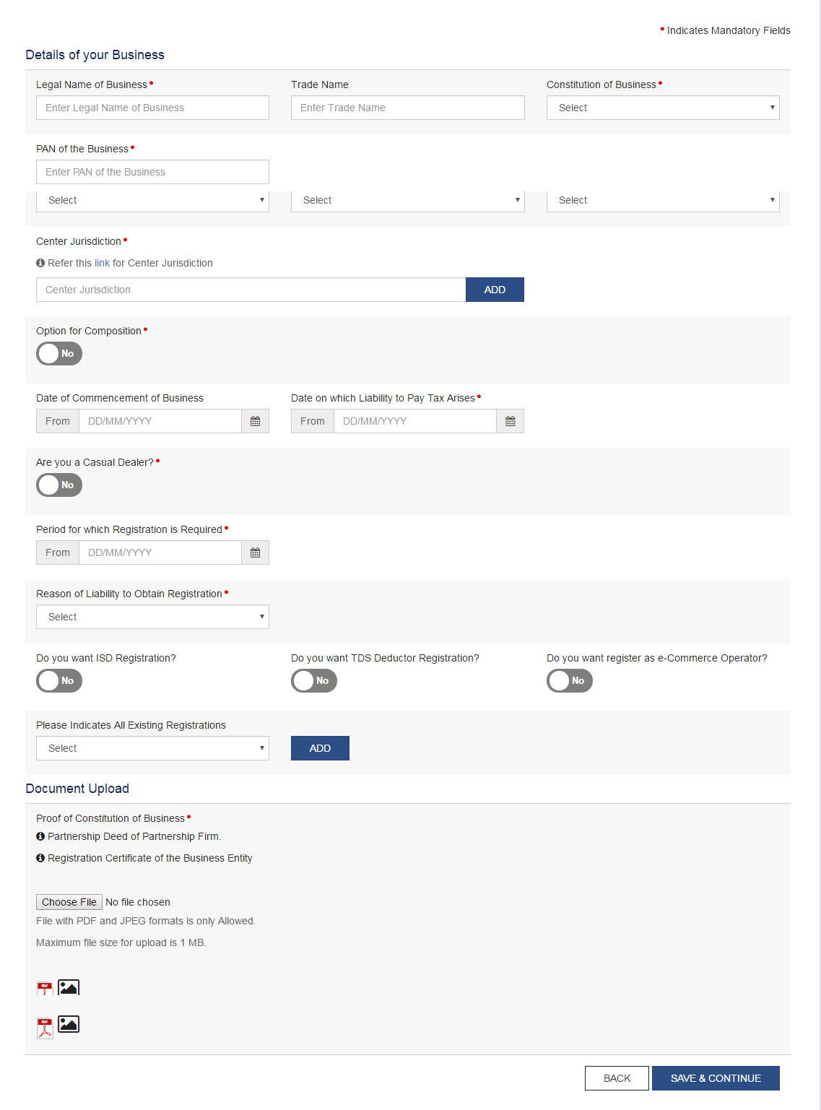
Registration
Registration for Taxpayers
How to Apply for a New Registration: Body of the Registration Form
This is an illustration of the Business Details section
All fields marked with red dot are mandatory and must be filled
Once you have entered all the details, you must attach the relevant documents (may not be applicable in all sections)
Click ‘Save & Continue’ to progress to the next section
Notes:
Facilitation Notes:

Slide 10
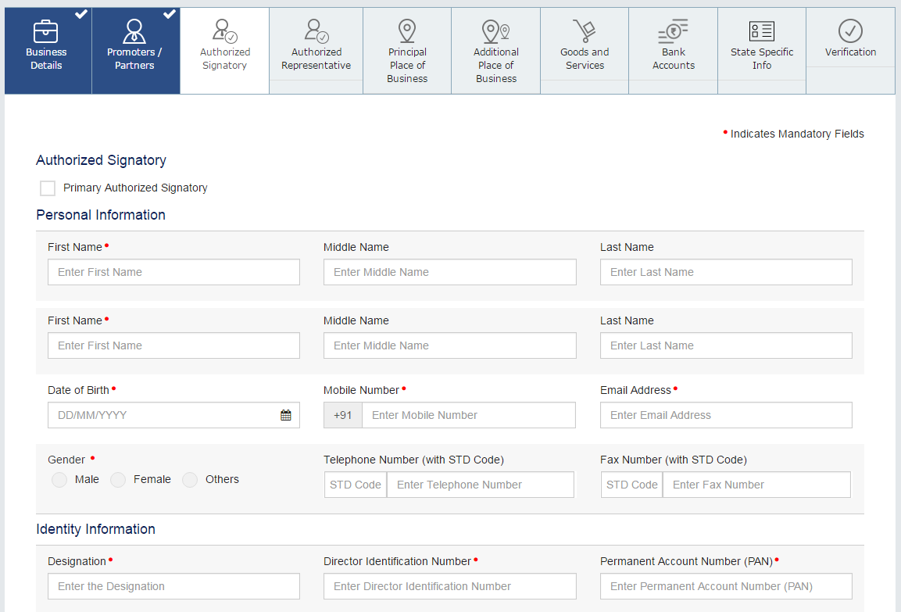
Registration
Registration for Taxpayers
How to Apply for a New Registration: Section – Authorized Signatory
Don’t forget to mark your Primary Authorised Signatory!
You can add up to 10 Authorised Signatories
Notes:
Facilitation Notes:
An applicant can add up to 10 authorised signatories however only one of them can be the Primary Authorised Signatory (PAS). It is mandatory to have a PAS.

Slide 11
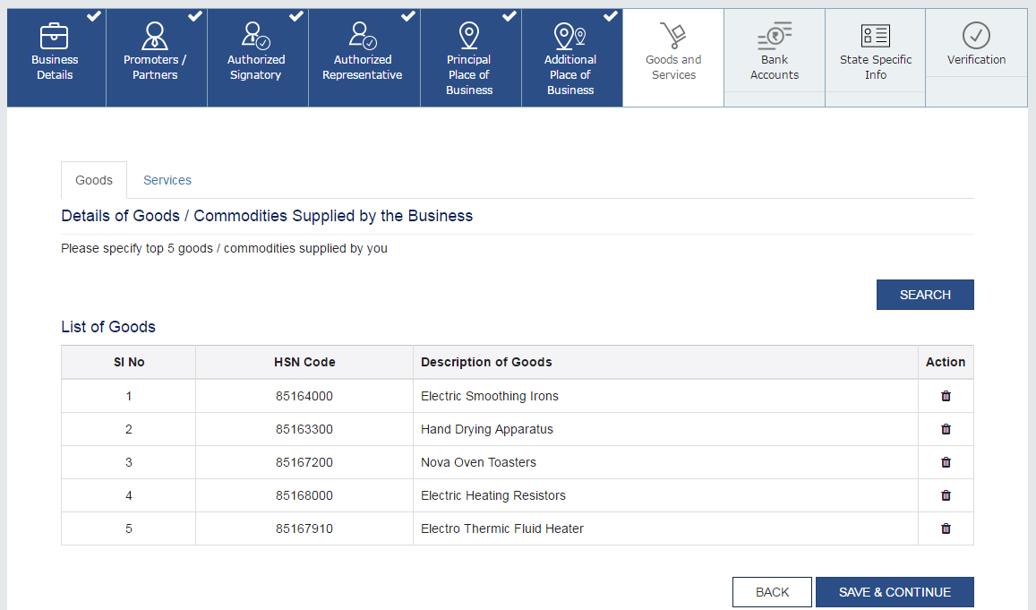
Registration
Registration for Taxpayers
How to Apply for a New Registration: Section - Goods and Services
Please specify Top 5 goods & Top 5 commodities only
Notes:
Facilitation Notes:
Please specify the top 5 goods & top 5 services only.
Question: A taxpayer will not register all goods and services, so can the tax official see anywhere how many goods/services a dealer is dealing with, or only registered goods/services?
Answer: This detail is expected to be provided through MIS reports.

Slide 12
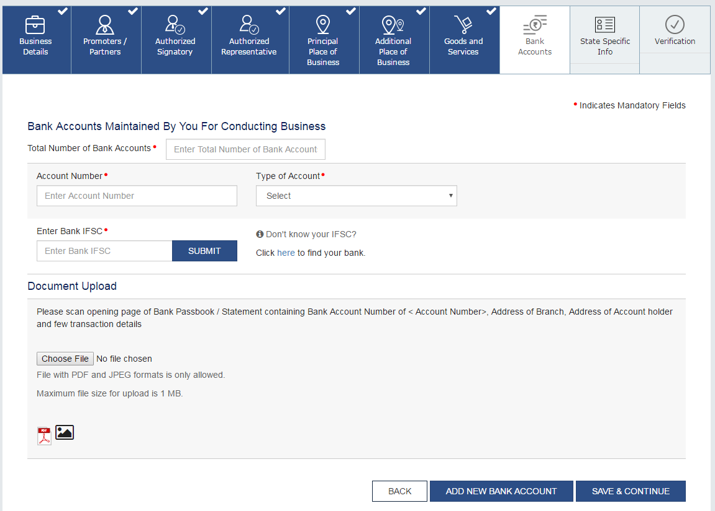
Registration
Registration for Taxpayers
How to Apply for a New Registration: Section - Bank Accounts
You can add up to 10 business bank accounts
Notes:
Facilitation Notes:

Slide 13
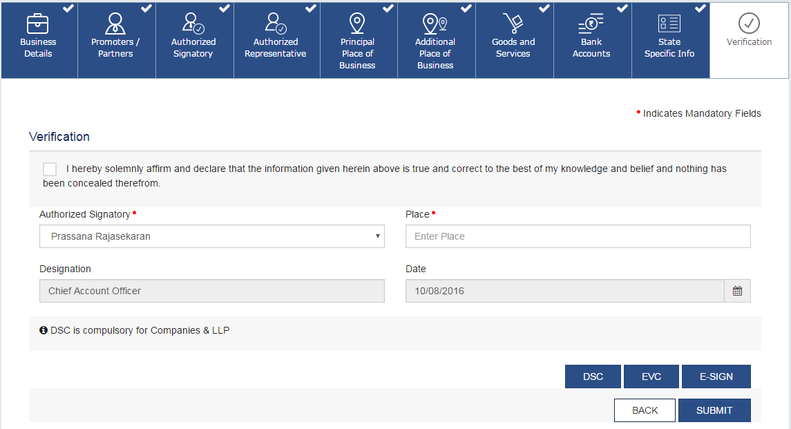
Registration
Registration for Taxpayers
How to Apply for a New Registration: Section - Verificationge
Before you can submit your application, you must
Check the box to accept the sworn affidavit
Digitally sign the application using DSC/E-Signature
Notes:
Facilitation Notes: N/A

Slide 14
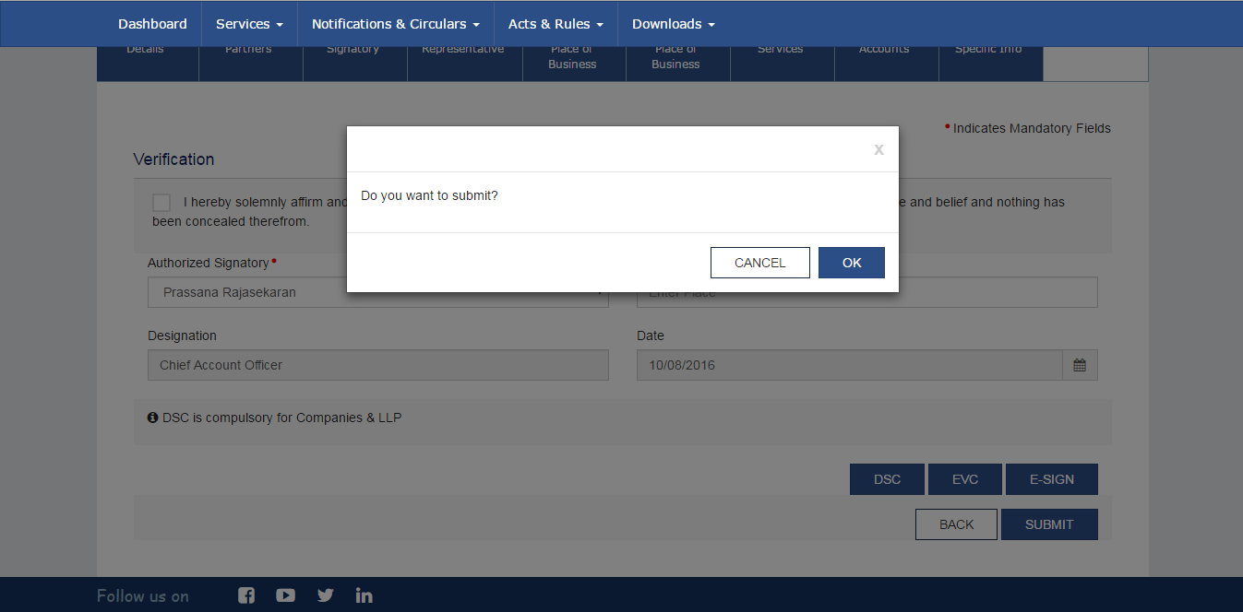
Registration
Registration for Taxpayers
How to Apply for a New Registration: Submit
After digitally signing the form, you can click on submit. Select OK to confirm your action.
Notes:
Facilitation Notes: N/A

Slide 15
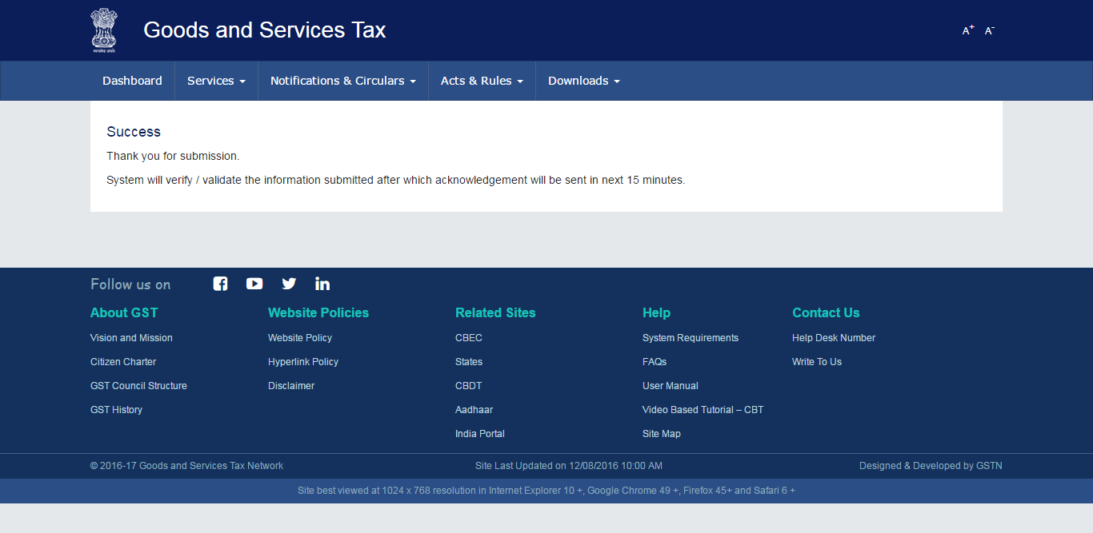
Registration
Registration for Taxpayers
How to Apply for a New Registration: Success
Congratulations! You have successfully submitted your GST Registration Application.
Notes:
Facilitation Notes: N/A

