Slide 1
LUT Filing

Slide 2
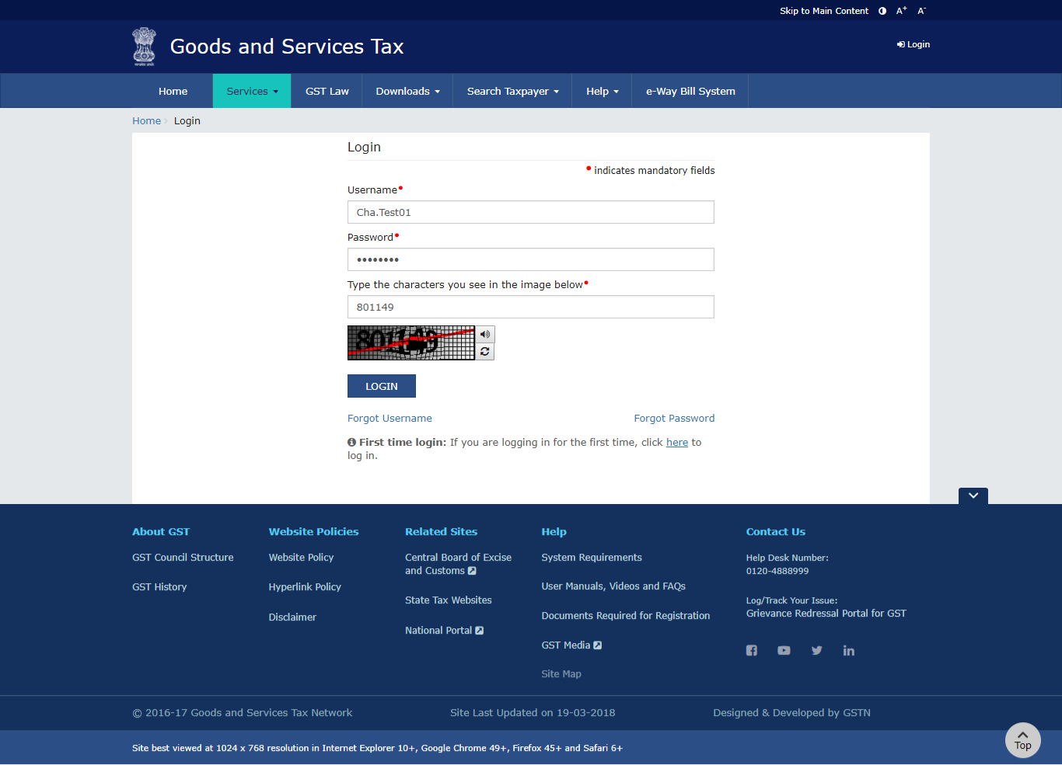
Taxpayer logs into GST Portal

Slide 3
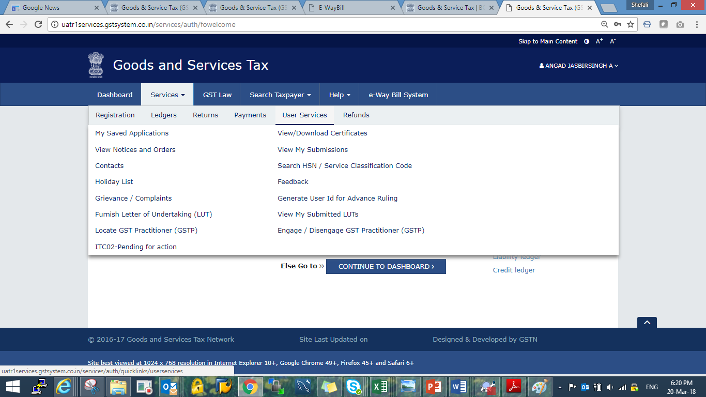
Navigate to menu option “Furnish Letter of undertaking (LUT)”

Slide 4
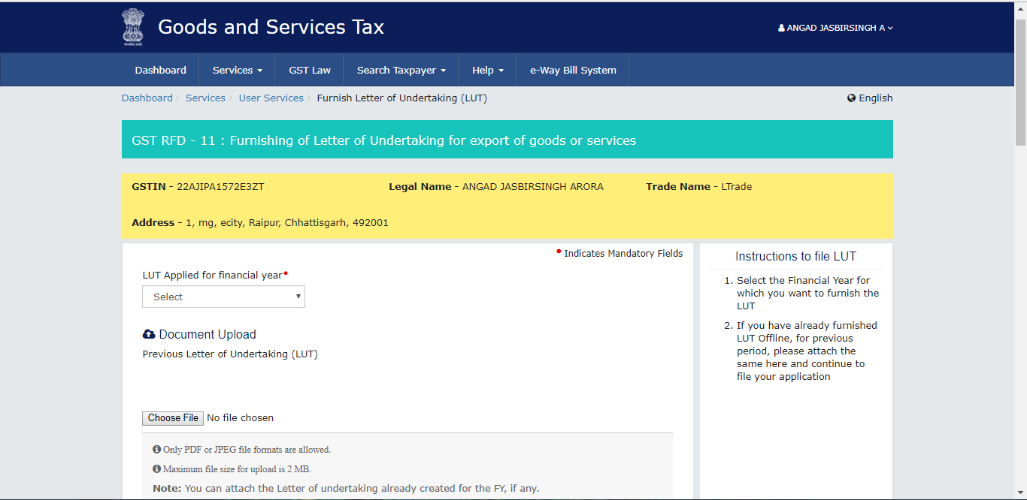
Application for LUT

Slide 5
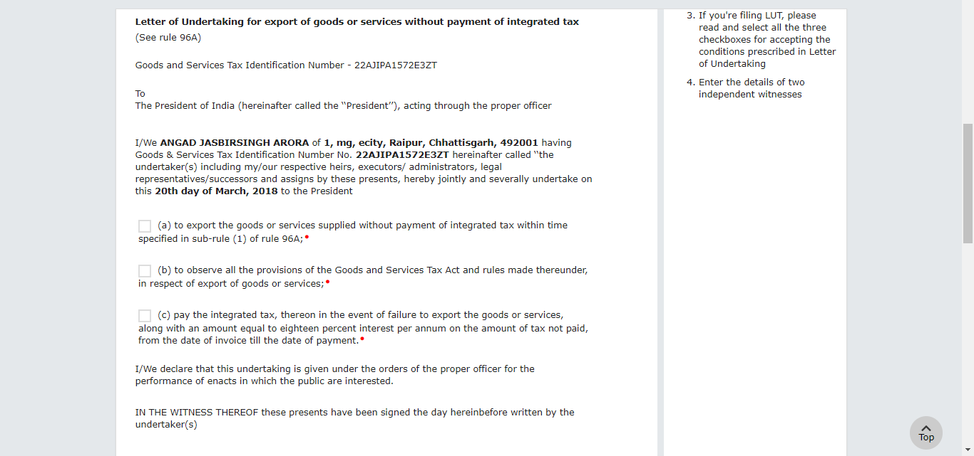
Letter of Undertaking

Slide 6
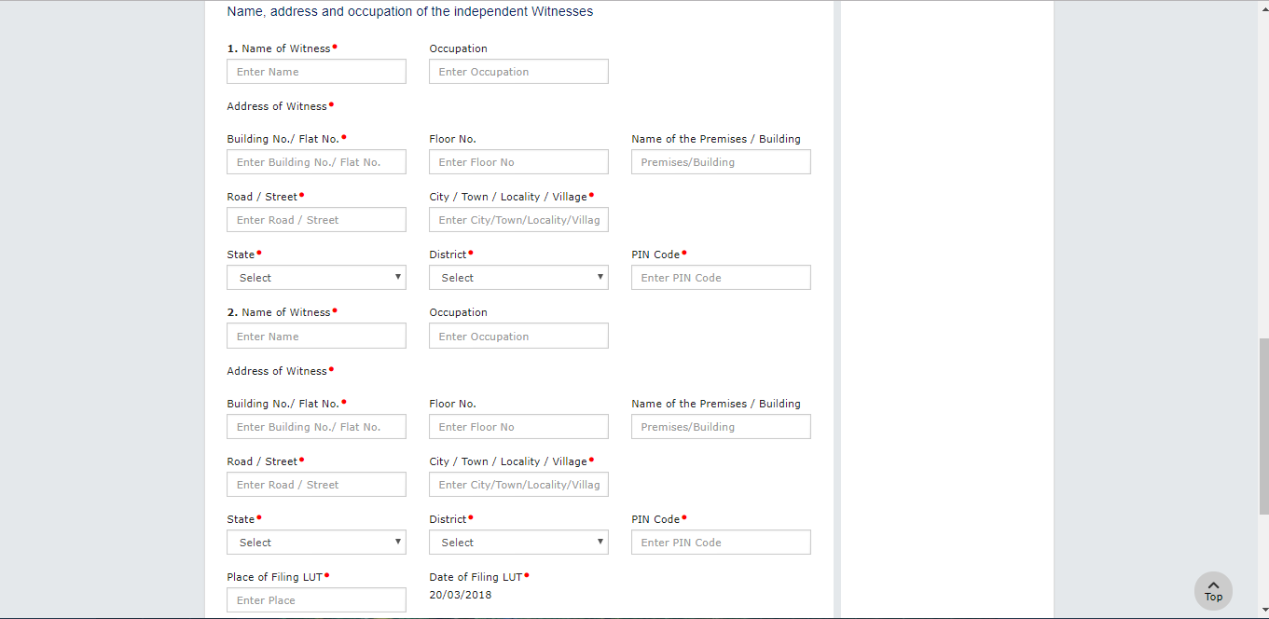
Independent Witness details for LUT

Slide 7
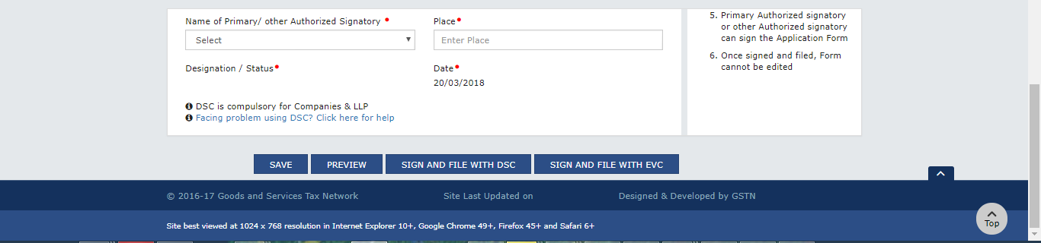
Verification for LUT

Slide 8
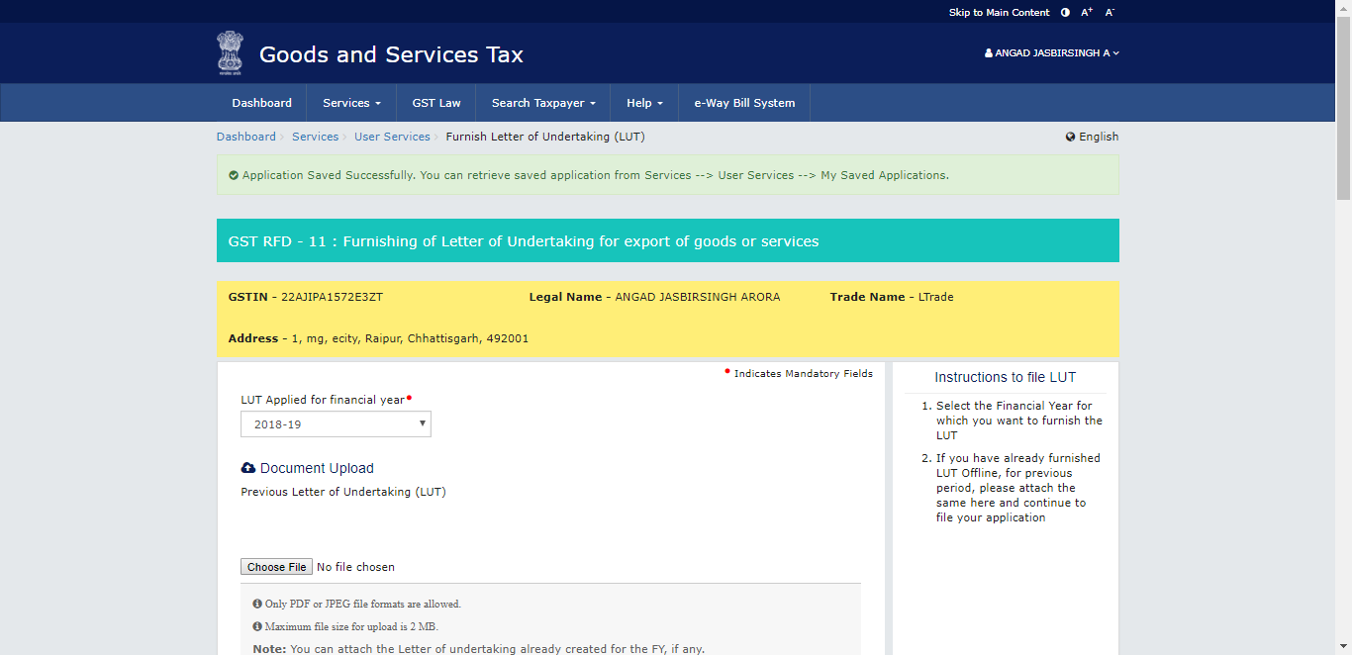
Application Saved Successfully

Slide 9
Navigate to menu option “My Saved Applications”

Slide 10
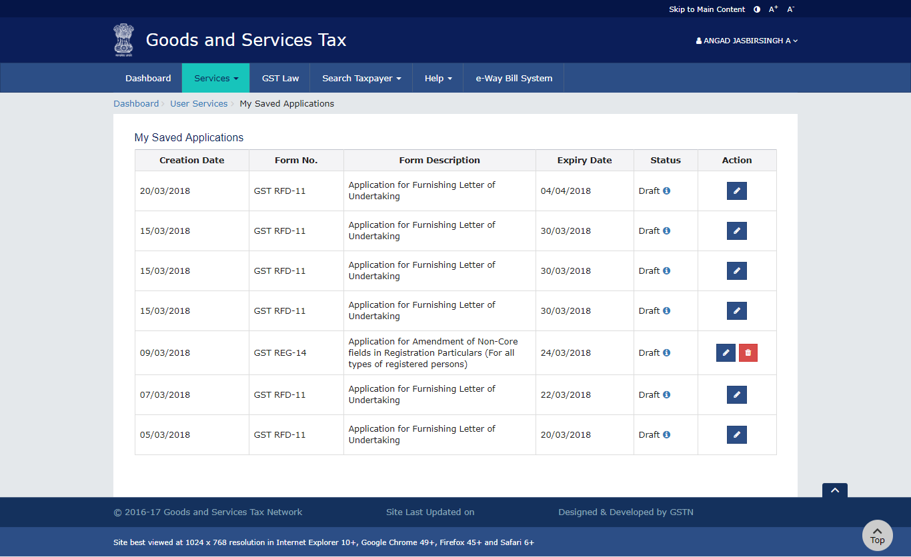
My Saved Applications

Slide 11
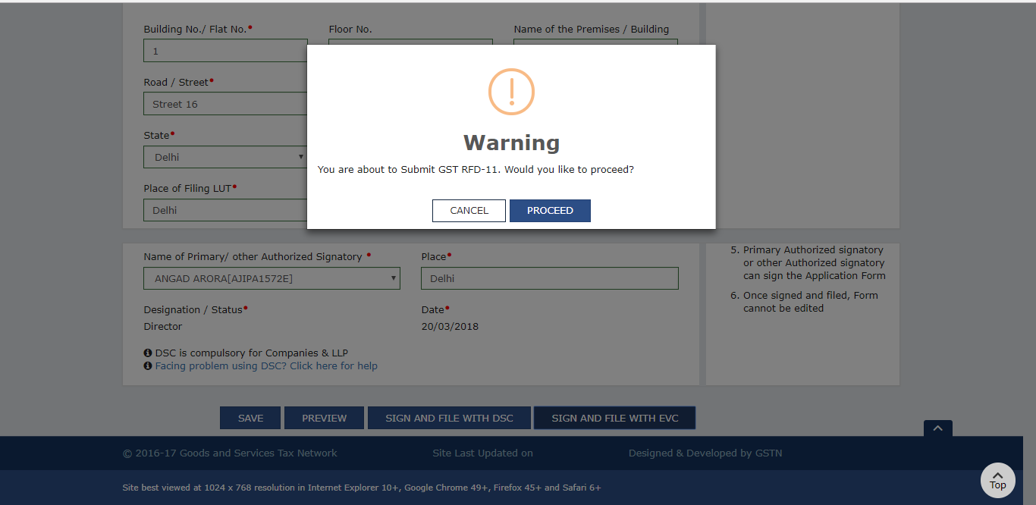
Application submit confirmation

Slide 12
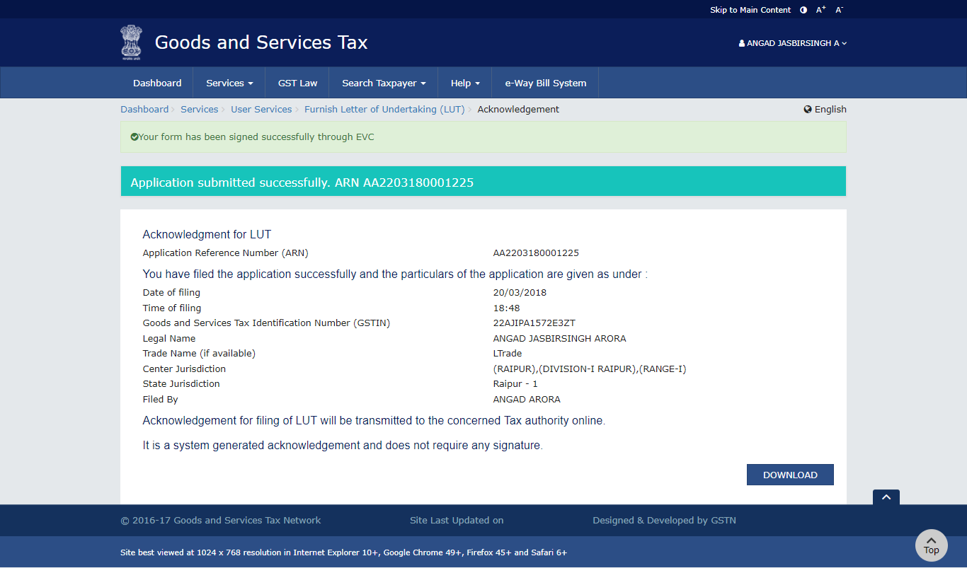
Acknowledgement

Slide 13
Navigate to menu option “View My Submitted LUTs”

Slide 14
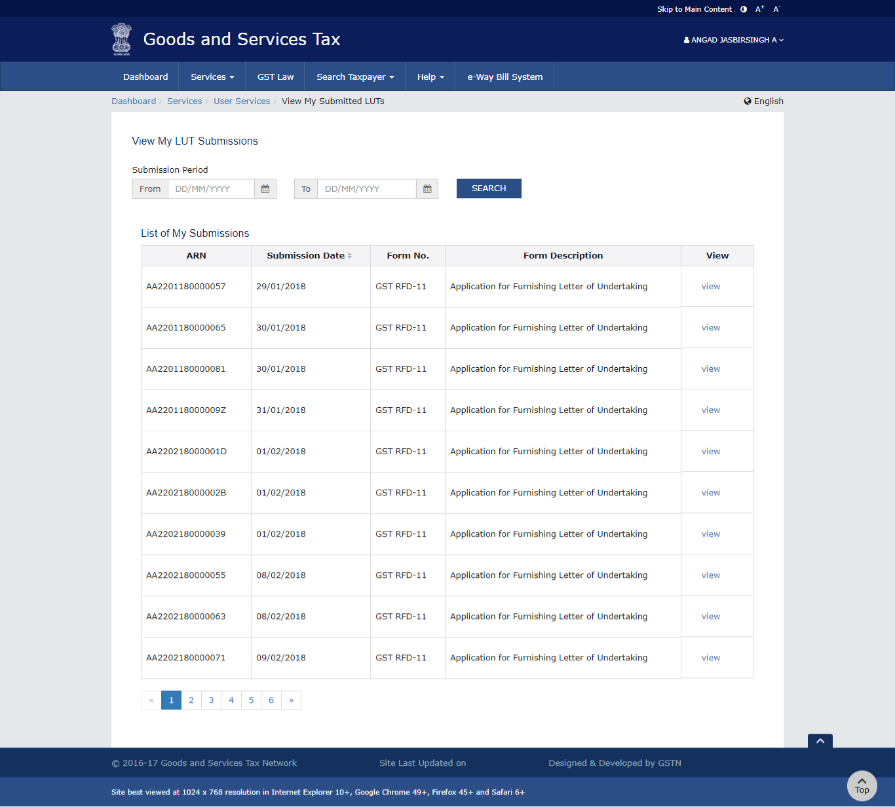
View My Submitted LUTs

