Slide 1
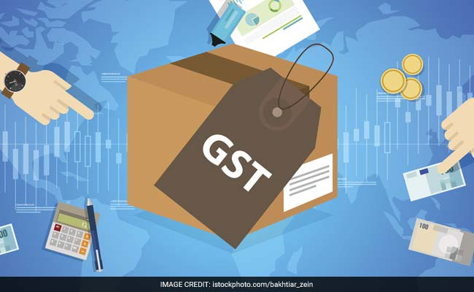
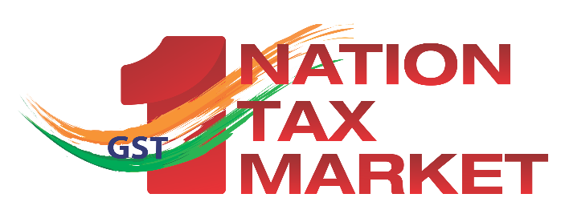

Basic Concepts of Transition & Invoice

Slide 2
Transitional Provisions
1
I was registered under existing law. How will I get ITC as on 01st July, 2017 ?
You’ll get ITC of amount carried forward in the return for 30th June, 2017, subject to conditions below:
You are normal taxpayer
Credit is admissible as ITC in GST
All returns from Jan-June 2017 submitted
Details to be filled in table 5 of GST TRAN-1 on common portal up to 30th September, 2017

Slide 3
Transitional Provisions
2
I was registered under existing laws. What about un-availed credit of Capital goods not carried forward in return?
You’ll get ITC of un-availed amount of duty paid on capital goods not carried forward in the return but relevant details need to be filled in table 6 of GST TRAN-1 on common portal up to 30th September, 2017

Slide 4
Transitional Provisions
3
I was a small business unregistered under existing laws. Will I get ITC if I register as normal taxpayer?
Yes. Credit of eligible duties in respect of inputs held in stock and inputs contained in semi-finished or finished goods held in stock on 01st July, 2017 will be available subject to specified conditions:

Slide 5
Transitional Provisions
4
I was registered under existing law as composition taxpayer. Will I get ITC if I register as a normal taxpayer?
Yes. Credit of eligible duties in respect of inputs held in stock and inputs contained in semi-finished or finished goods held in stock on 01st July, 2017 will be available subject to specified conditions:

Slide 6
Transitional Provisions
5
My supplies were exempt under existing law. Can I claim ITC if my goods becoming taxable in GST?
Yes. Credit of eligible duties in respect of inputs held in stock and inputs contained in semi-finished or finished goods held in stock on 01st July, 2017 will be available subject to specified conditions:

Slide 7
Transitional Provisions
6
I was registered as FSD/ SSD/registered importer/ depot of manufacturer. Can I claim ITC if I register as normal taxpayer?
Yes. Credit of eligible duties in respect of inputs held in stock and inputs contained in semi-finished or finished goods held in stock on 01st July, 2017 will be available subject to specified conditions:

Slide 8
Transitional Provisions
Conditions
Inputs or goods are used for making taxable supplies
Eligible for ITC under GST
Possession of invoice or documents (CTD) evidencing payment of duty
Invoices or other documents not issued prior to 30th June, 2016
File declaration of stock of duty paid goods in table 7 of GST TRAN-1 on common portal up to 30th September, 2017

Slide 9
Transitional Provisions
7
I was a small business unregistered under existing laws. What happens if I don’t have the duty paying documents?
Scheme (for 6 months starting July 2017) for traders only subject to specified conditions:
ITC @ 60%/40% of GST paid where GST rate payable on the goods is above/below 18%
Document of procurement of goods is available

Slide 10
Transitional Provisions
Conditions
Goods were not unconditionally exempt
ITC allowed after the GST is paid subject to the condition that benefit of such credit is passed on to the customers
Declaration filed in GST TRAN-2 at the end of every month

Slide 11
Transitional Provisions
8
Will I get ITC of VAT? What about ITC of CST?
Yes. ITC of VAT reflected in the last return will be allowed to be carried forward as SGST Credit.
ITC for CST (C/F/H/I forms under CST) is not allowed to be carried forward.

Slide 12
Transitional Provisions
9
I was an ISD under existing laws. Will I be able to distribute ITC related to earlier laws in GST?
ISDs will be able to distribute the credit for services received prior to 1st July, 2017, even if invoice(s) relating to such services is received on or after 1st July, 2017.

Slide 13
Transitional Provisions
10
I was centrally registered & providing services under existing laws. Will I get ITC if I register in GST? Can I distribute it?
You can take credit of the amount of CENVAT carry forward in last return furnished under the existing law.
Such credit may be transferred to any of the registered units having the same PAN for which central registration was taken under the existing law by filing table 8 of GST TRAN-1.

Slide 14
Transitional Provisions
11
My appeal /revision/refund relating to CENVAT/ITC is pending. What will be the fate of these proceedings?
All proceedings under the existing laws, whether initiated before, on or after 1st July, 2017, will be disposed of in accordance with the existing law.
Refund, if admissible, will be disposed under existing laws.
Recovery will be made under GST laws if not recovered under existing laws.

Slide 15
Transitional Provisions
12
My contract was done before 1st July, 2017 but supply received after 1st July. What tax to charge?
GST will be charged if tax on supply has not been levied under the existing law.

Slide 16
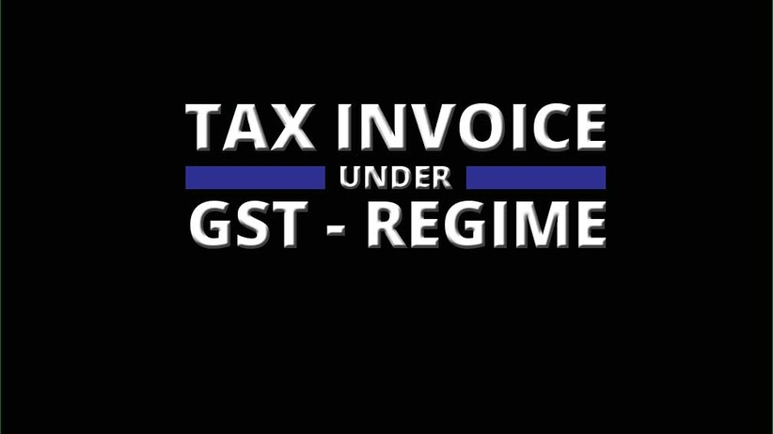

Slide 17
Who can raise a tax invoice?
Registered Person
Supplying taxable goods or services
Receiving taxable goods or services from unregistered supplier

Slide 18
IMPORTANT CONTENTS OF TAX INVOICE
GSTIN of supplier
Consecutive Serial Number & date of issue
GSTIN of recipient, if registered
Name & address of recipient, if not registered
HSN
Description of goods or services
Quantity in case of goods

Slide 19
IMPORTANT CONTENTS OF TAX INVOICE
Total Value of supply
Taxable Value of supply
Tax rate – Central tax & State tax or Integrated tax, cess
Amount of tax charged
Place of supply
Address of delivery where different than place of supply
Tax payable on reverse charge basis
Signature of authorised signatory

Slide 20
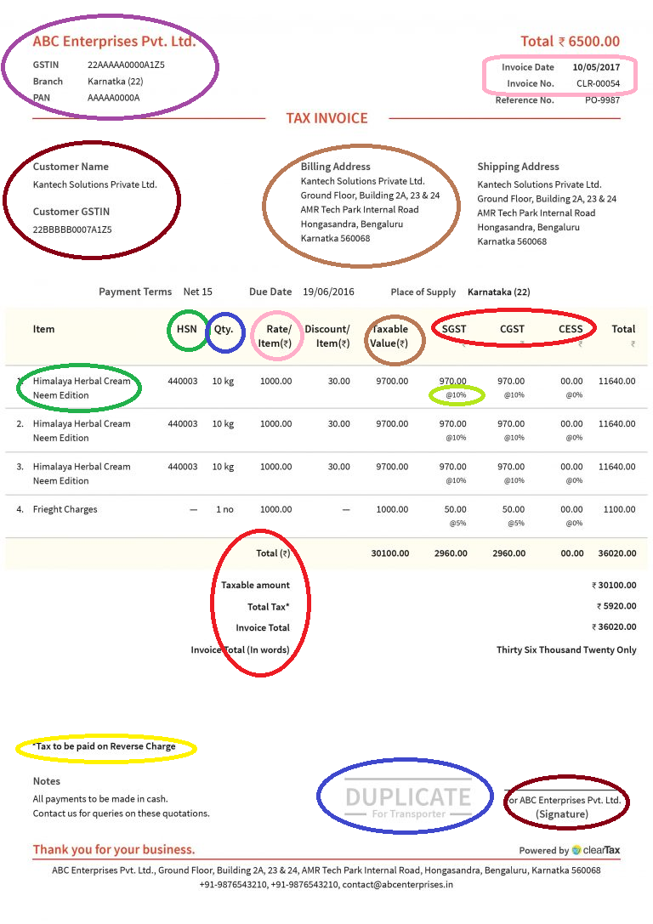
What should be there in a tax invoice?

Slide 21
Digits of HSN Codes to be included: Notification 12/2017-CT, dated 28.06.2017
Annual Turnover in the preceding FY | Number of Digits of HSN Code
Up to Rs. 1.5 Crore | Nil
More than Rs. 1.5 Crore and up to Rs. 5 Crores | 2
Above Rs. 5 Crores | 4

Slide 22
How to raise an invoice?
Supply of Goods | Supply of services
Triplicate | Duplicate
Original copy for recipient Duplicate copy for transporter; and Triplicate copy for supplier | Original copy for recipient; and Duplicate copy for supplier
The serial number of invoices issued during a month / quarter shall be furnished electronically in FORM GSTR-1

Slide 23
When to raise an invoice?
Taxable supply
Goods
Involving movement of goods
No movement of goods
Services
Within 30 days from the supply of services
At the time of removal
At the time of delivery
Insurance, Banking - 45 days
Sale or return supplies
Before or at the time of supply, or within 6 months from the removal – w.e. is earlier

Slide 24
Special cases
Type of invoice/document | When to issue
Bill of supply | Supply of exempted goods or services or under composition levy
Revised invoices | For invoices issued during the period between effective date of registration and issuance of R.C.
Receipt voucher | Receipt of advance payments
Refund voucher | Return of advance payments

Slide 25
Special cases
Type of invoice/document | When to issue
ISD invoices | Input Service Distributors
Other document | Insurance/ banking company/transporter/ airlines
Delivery challans | In lieu of invoice in specific cases
Export invoices | shall carry the endorsement: “supply meant for export on payment of integrated tax” or “supply meant for export under bond or letter of undertaking without payment of integrated tax”

Slide 26
Credit Note
Tax invoice raised
Taxable value or tax charged is found to be in excess, or
Goods are returned, or
Goods or services are found to be deficient
CREDIT NOTE
No time limit for issuing a CN, but liability can be adjusted only until next September after the FY in which supply was made, or until the due date for filing annual returns, whichever is earlier, provided recipient has reversed ITC

Slide 27
Debit Note
Tax invoice raised
Taxable value or tax charged is found to be less than the actual amount
DEBIT NOTE

Slide 28
Thank You
The following material is available on
www. cbec.gov.in
www.cbec-gst.gov.in
Presentation on GST
GST – Concept & Status
FAQs on GST in Hindi, English and 10 regional languages
CGST, UTGST, IGST & Compensation Acts
CGST Rules
Constitutional Amendment Act

